Slide 1
Get Britain Working Trailblazer and Connect to Work Update Webinar

Slide 2
Webinar Running Order…
Update on the Get Britain Working Inactivity Trailblazer – Tracy Watts, Skills & Employability Manager, YNYCA
Economic Inactivity In York & North Yorkshire: A Snapshot – Chris Chester, Delivery Officer YNYCA
Update on Connect to Work Programme – Abi Player, Skills Officer, YNYCA
Next Steps & Closing – Tracy Watts

Slide 3
Get Britain Working – Inactivity Trailblazer
£125M in 8 areas across England and Wales to mobilise local work, health and skills support and join up local support services.
Trailblazers are scheduled to run from April 2025-March 2026.
Each inactivity trailblazer will receive up to £10m funding to deliver the approach in 2025/26

Slide 4
Get Britain Working – Inactivity Trailblazer
The three key objectives of economically inactive trailblazers are to:
Maximise the reach, effectiveness and impact of the range of existing services that could support people who are economically inactive to participate in the labour market, by transforming how partners and services work together locally;
Test new and innovative approaches to: ​
Identifying and engaging people who are economically inactive​
Supporting people who are economically inactive to participate in the labour market; and
Provide a platform for longer-term systems reform, to deliver a coherent, joined-up local work, health and skills offer​.

Slide 5
Get Britain Working Inactivity Trailblazer
Overarching themes:
Building an inclusive and thriving workforce
Addressing economic inactivity with a focus on those with disabilities and health issues
Increasing levels of engagement and employment
Data & Evidence based – Understanding who are our ‘inactives’ and what are their characteristics and challenges
Shaping and developing a strong joined up local work, health and skills offer – considering how existing and new resources will be used

Slide 6
YNY Trailblazer Timeline
Jan-March 2025 Implementation phase:
Partner engagement
Data & evidence base
Strategic Priorities
Evaluation Framework
Delivery starts
April 2025-March 2026

Slide 7
Get Britain Working Inactivity Trailblazer
Implementation Phase - Partner Engagement:
Webinar
Survey: Work, Health and Skills. Please return by Friday 31st January
In Person Event: Friday 14th February, The Milner, York

Slide 8
Inactivity – Definitions
The UN Labour Organisation defines Economic Inactives as:
“Economically Inactive people are those without a job and have not sought work in the last 4 weeks and would not be available to start work in the next 2 weeks”
The UK Office of National Statistics defines Economic Inactives as:
Over 16 years of age
Not in employment
Not waiting to start a job which has already been offered and accepted
Has not looked for work in 4 weeks
Could not begin work within 2 weeks

Slide 9
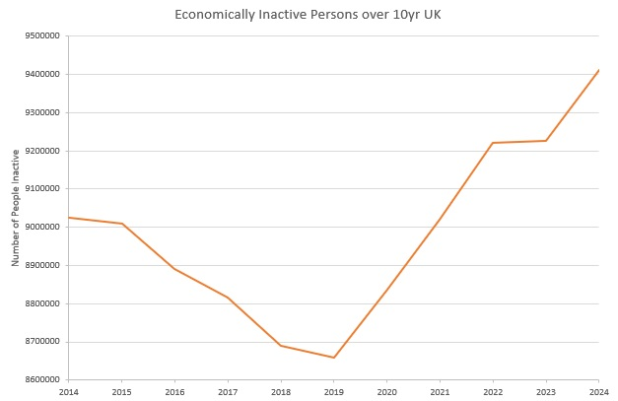
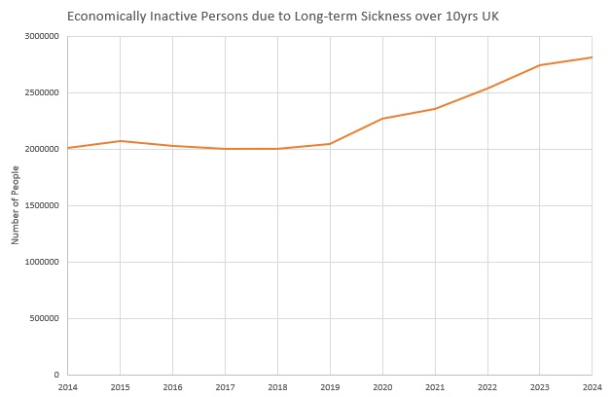
Inactivity – National Trends
The number of people Economically Inactive in the UK has been rising overall since 2019
Significant increase in Inactivity due to Long-term Sickness since 2019 is a large contributing factor nationally

Slide 10
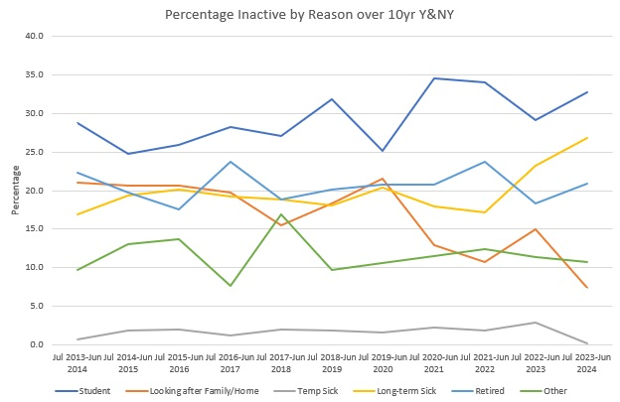
Inactivity – Y&NY - Reasons
Y&NY shows a similar trend for increasing economic inactivity because of Long-term Sickness as at the National level
Y&NY has above National levels of Economic Inactivity because of (early) Retirement
Y&NY has below National levels of Economic Inactivity because of Looking After Family/Home

Slide 11
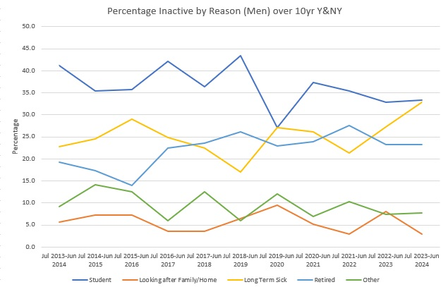
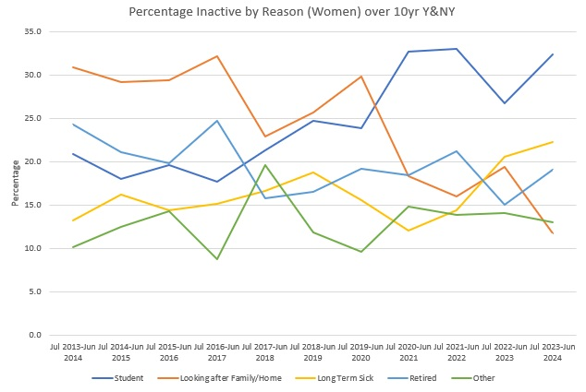
Inactivity – Y&NY - Reasons
The trend of increasing Inactivity due to Long-term Sickness is similar in both Men and Women within Y&NY
Increase in Long-term Sickness Inactivity began in 2019 for Men and 2021 for Women

Slide 12
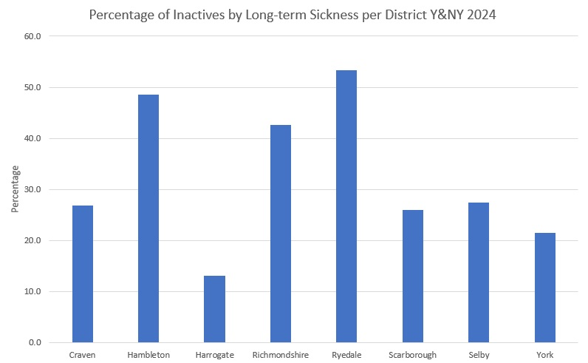
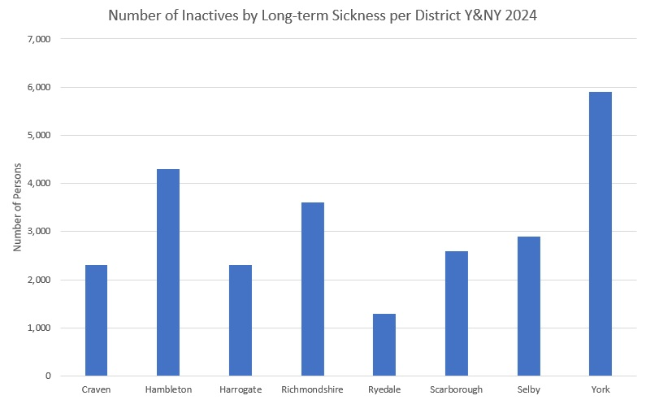
Inactivity – Y&NY – Long-term Sick
Districts with a high percentage of Inactivity because of Long-term Sickness in Y&NY are:
Hambleton, Richmondshire, and Ryedale
For both Hambleton and Richmondshire this directly translates to a high number of people Inactive because of Long-term Sickness
York has a high number of people Inactive because of Long-term Sickness because of being a large population centre

Slide 13
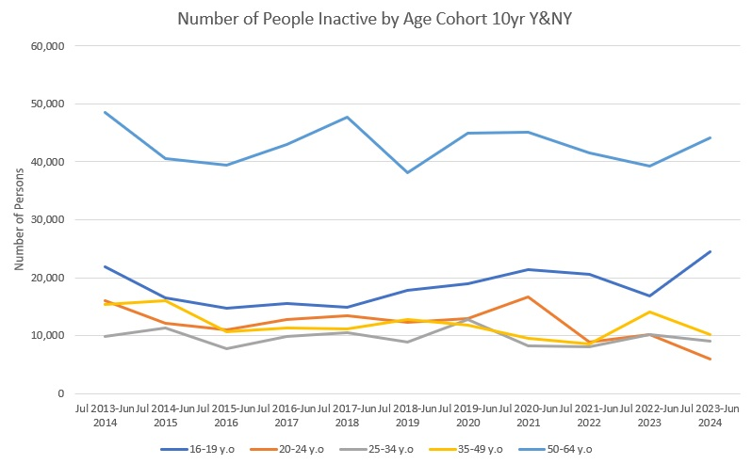
Inactivity – Y&NY - Age Groups
Y&NY has its highest rates of Inactivity in the 16-19y.o and 50-64y.o age groups
The 16-19 y.o age group has seen an overall increase since 2017/2018
Both 16-19y.o and 50-64y.o age groups have seen a sharp increase since 2022

Slide 14
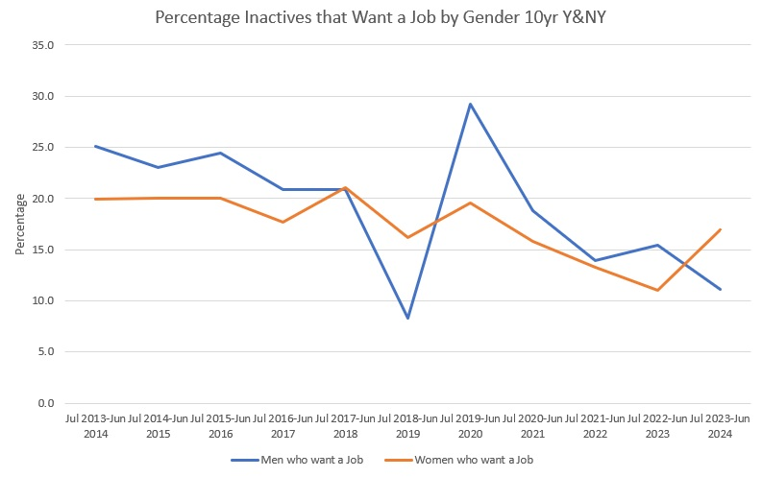
Inactivity – Y&NY - Wants a Job
Decrease in people economically inactive who Want a Job since 2019/2020 in Y&NY
Inactive Men have seen a sharper decrease in Wanting a Job than Women in this time
Inactive Women have seen an increase in Wanting a Job since 2022
A Lower % of Inactive Men now want to return to work than Inactive Women
These trends are also the same when looking at numbers

Slide 15
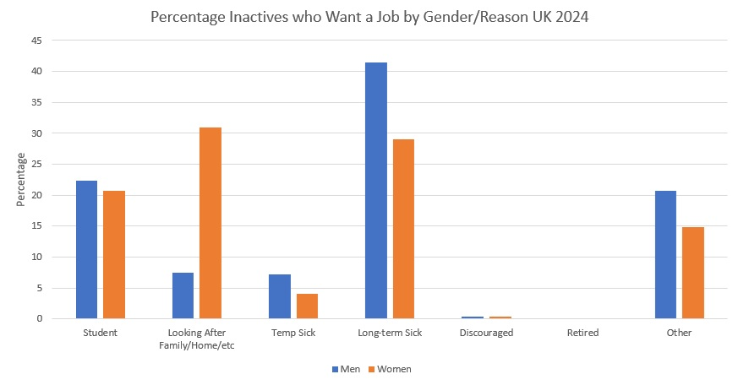
Inactivity – National – Wants a Job
National trends for groups of inactive people who Want a Job
Group with highest percentage of people that Want a Job is: Men who are Long-term Sick
2nd Highest is: Women who are looking after Family/Home
3rd Highest is: Women who are Long-term Sick
People Inactive because of (early) Retirement show a 0% sentiment of Wanting a Job

Slide 16
Inactivity – Gaps and Questions
Large gaps in terms of data on what types of health conditions are causing people to be economically inactive due to long-term health in the region
We know from national trends (ONS reporting) that people are reporting multiple conditions and the most prevalent health conditions are relating to mental health or muscular-skeletal issues
We are aiming to work with partners in Health to help get greater insight into different health conditions in relation to economic inactivity
We would like to get more information on the geographic location of different cohorts of inactives within Y&NY
Some census data is currently available on this, but it does not give us a complete picture and has gaps at this more granular level
We are aiming to work with partners in Local Authorities to help get greater insight into where people who are economically inactive may be concentrated

Slide 17
Connect to Work Programme – Key Headlines
Central Government Supported Employment Programme
YNYCA is the Accountable Body
Supporting people with disabilities, health conditions and additional barriers
Aims to get people into employment and support them when in employment
Annual funding at peak of 900 individuals c £3.3M
Flexible, tailored support to meet the needs of the individual and employer
Key elements of the model: engagement, vocational profiling, job matching, employer engagement, on and off the job support
Programme will deliver for 3 years (potential for 2+)
Programme uses two fidelity models; IPS and SEQF

Slide 18
Connect to Work Programme –
Timeline & Next Steps
Jan-June 2025 Implementation Phase
Partner engagement
• Development of Delivery plan
Oct-Nov 2025
Go live delivery
July- Sept 2025
Procurement process
Next steps
In person event 14th February in York
Market engagement events in throughout March

Slide 19
Next Steps…
Survey: Work, Health and Skills. Please return by Friday 31st January
In Person Event: Friday 14th February, The Milner, York
Connect to Work Partner Events – March (dates to be confirmed)

Slide 20
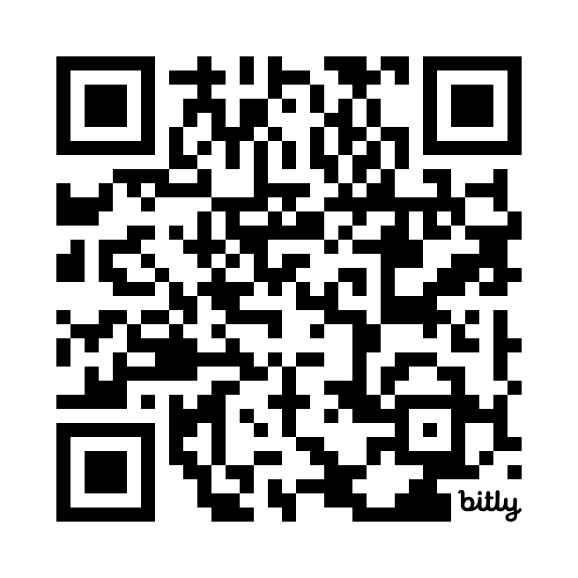
Scan the QR code to complete our survey
Registration for our event on Friday 14th February, The Milner, York, is open on our website now: yorknorthyorks-ca.gov.uk

