Slide 1
The webinar will start soon Adult Skills Fund Key Information Competitive Tendering Process 2025

Slide 2
Adult Skills Fund Key Information Competitive Tendering Process
25th February 2025

Slide 3
Agenda Note: Session to be recorded and session slides /recording will be distributed
Brief introduction / background – Debbie Walton, YNYCA
Learning programmes to be procured - Debbie Walton, YNYCA
Procurement timescale projection– Debbie Walton, YNYCA
Adult Skills and Learning Dynamic Purchasing System– Chloe Wilcox, Head of Procurement

Slide 4
Introduction Debbie Walton ASF Commissioning and Contracting Officer

Slide 5
Adult Skills Fund Background
Event | Date
Stakeholder Engagement & Research | Started in Spring 2024
Launch of the ASF Strategic Skills Plan | September 2024
Competitive Tendering Process Webinar | November 2024

Slide 6
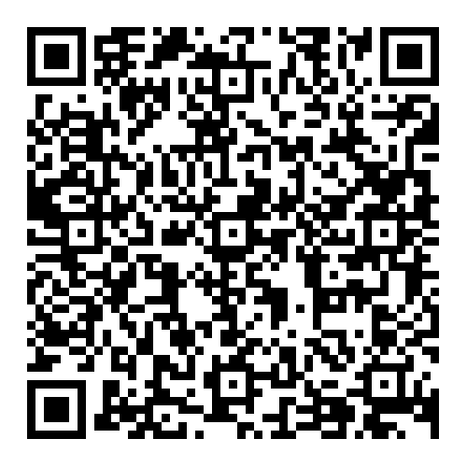
Adult Skills Fund Strategic Skills Plan
https://yorknorthyorks-ca.gov.uk/wp-content/uploads/2024/10/ASF-Strategic-Skills-Plan-September-2024.pdf

Slide 7
Adult Skills Fund Strategic Priorities
Widen Access & Participation: ASF as a gateway to learning and progression
Develop Flexible Provision: to meet the needs of learners and businesses
Embed Basic & Transferable Skills: ASF providing foundations to higher skills and employment
Build Capacity and Capability: to enable an integrated, flexible and responsive provider base
Unlock Progression Pathways and Underutilised Talent: ASF providing routes to higher skills and better paid jobs
Enable Effective Collaboration: partnership working between providers

Slide 8
An introduction to the Crown Commercial Service Dynamic Purchasing System (DPS)
Information about advice and assistance available
Key information about anticipated timescales for future procurement activity under method 3 (Contract for Services via competitive tendering process) of York and North Yorkshire Combined Authority’s Adult Skills Fund Commissioning Plan.
https://yorknorthyorks-ca.gov.uk/adult-skills-fund-webinar-resources/

Slide 9
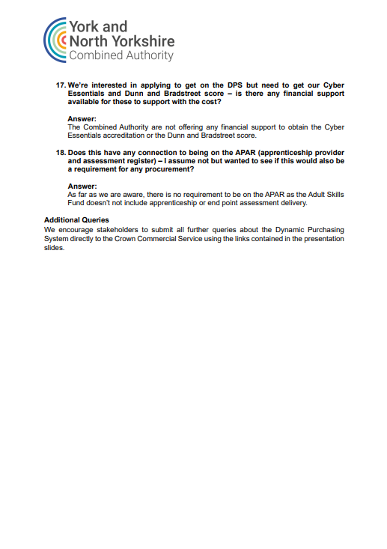
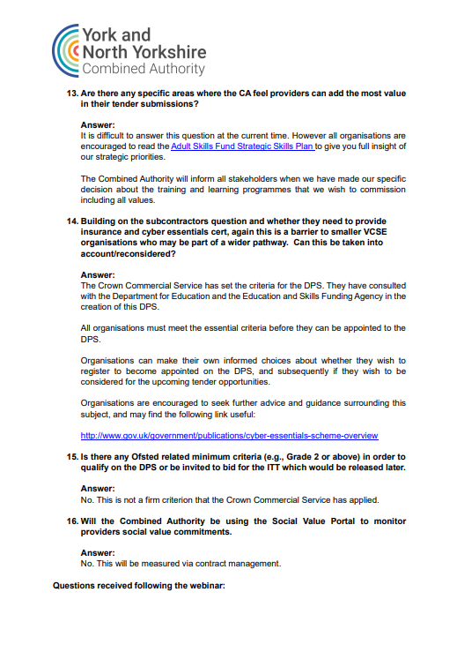
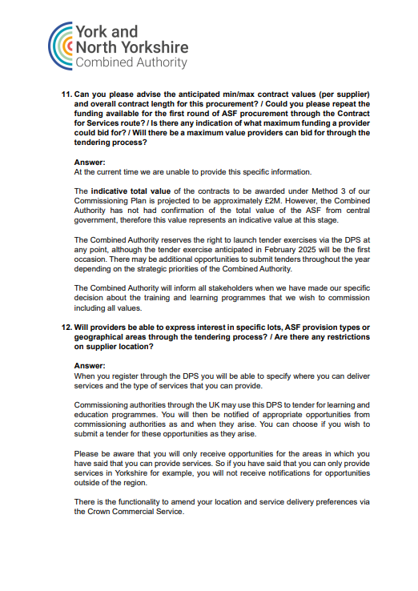
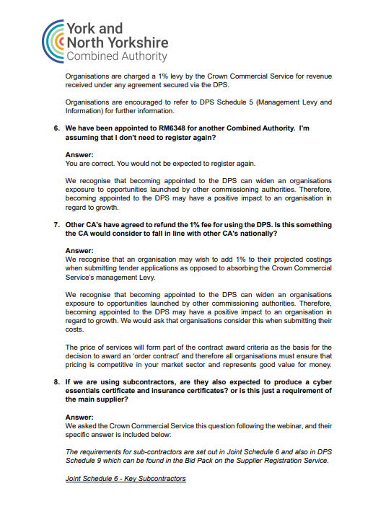
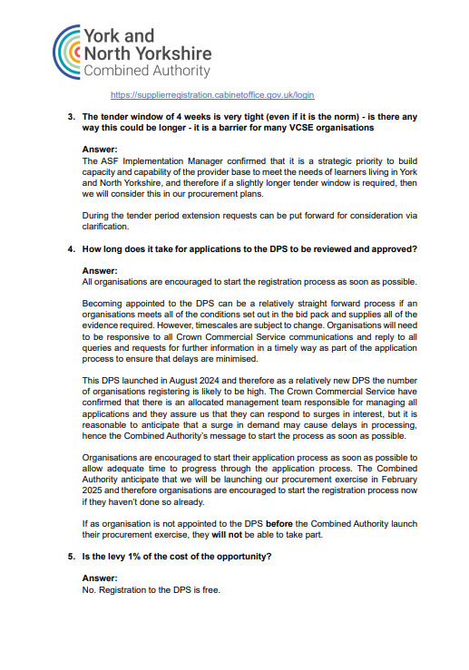
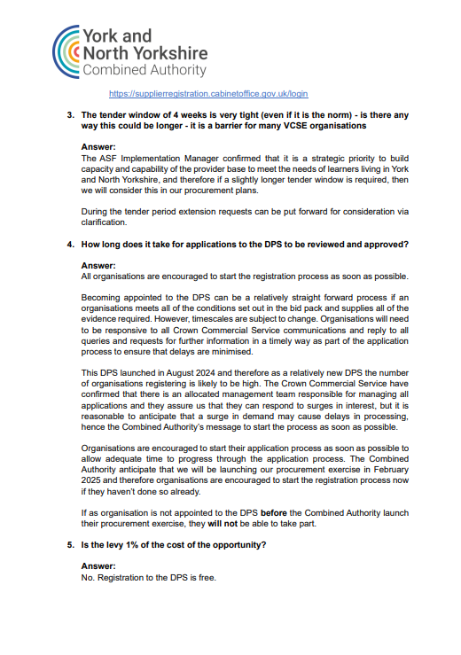
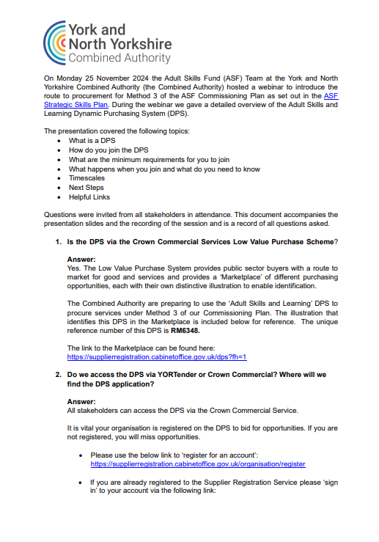
November 2024 Q&A https://yorknorthyorks-ca.gov.uk/wp-content/uploads/2024/11/Adult-Skills-Fund-Webinar-251124-QA.pdf
Clarification Questions:
https://supplierregistration.cabinetoffice.gov.uk/dashboard/clarifications?cid=%40%3DUFVWRVR6VkZhazQ9NjJNT08

Slide 10
Appointments to the Adult Skills and Learning Dynamic Purchasing System (DPS)
APPOINTED SUPPLIERS
https://supplierregistration.cabinetoffice.gov.uk/dps-suppliers/asl
QUERIES:
CCS Enquiries Service Desk: info@crowncommercial.gov.uk

Slide 11
Learning Programmes to be Procured

Slide 12
Three multi-LOT tender exercises
Level 3 Learning Programmes: 2 LOTS
ASF Funded Regulated Qualifications: 6 LOTS
Tailored Learning: 2 LOTS
https://yorknorthyorks-ca.gov.uk/wp-content/uploads/2024/10/ASF-Strategic-Skills-Plan-September-2024.pdf
Please note: All LOTS above will have a social value question included.
The social value question will link directly to the Adult Skills Fund Strategic Priorities
https://yorknorthyorks-ca.gov.uk/wp-content/uploads/2024/10/ASF-Strategic-Skills-Plan-September-2024.pdf

Slide 13
Projected Procurement Timescales Method 3 – ASF Commissioning Plan. all timescales are: 1/ subject to change 2/ subject to the transfer of powers for ASF by Government
November 2024 – January 2025 | Suppliers Appointed to DPS
11th March 2025 (Subject to Change) | Tender Exercise
April 2025 | Scoring
May 2025 | Notification of Award
May / June 2025 | Issuing Contracts
June 2025 – July 2025 | Inception / Mobilisation
August 2025 | Anticipated Contract Start Date

Slide 14
Adult Skills and Learning Dynamic Purchasing System (DPS) Chloe Wilcox Head of Procurement

Slide 15
Crown Commercial Service
Dynamic Purchasing System
Adult Skills and Learning

Slide 16
CCS have designed their DPS to ensure the appropriate bodies and businesses are appointed. To achieve this, they have set the below minimum requirements which your business must be able to meet.
Minimum requirements summary
Cyber Essentials basic certification
Minimum insurance requirements:
Employer’s liability insurance of £5,000,000
Public liability insurance of £5,000,000
Professional indemnity insurance of £1,000,000
Compliance with the Supplier Code of Conduct and Modern Slavery Act
Pass a Financial Viability and Risk Assessment (FVRA)
Provide a valid UK Provider Reference Number (UKPRN) from the UK Register of Learning Providers
Agree to help contracted buyers to achieve their social value objectives

Slide 17
When York and North Yorkshire Combined Authority advertises an opportunity, you will receive an alert of this which will then allow you to view the tender and if interested, submit a bid.
For any consortium bids, you can work and collaborate with other suppliers/legal entities to form a consortium. If this route is taken, a lead member will need to be named and nominated and that is who must submit the tender bid. Each member who forms the consortium must be named in the tender documents (Your request to participate document).
Any clarifications you wish to raise must be raised through the CCS system, during the tender period. York and North Yorkshire Combined Authority will not be able to respond to clarifications outside of the system and past the deadline. All suppliers on the DPS must be given the same information, and the same opportunity.

Slide 18
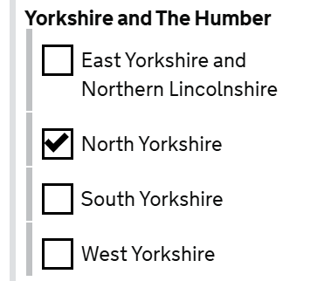
We will:
Use the DPS filters to generate a list of suppliers using delivery location and Sector Subject Area filters
We will invite tenders from suppliers in the generated list by contacting them directly.
All relevant information will be included in the invitation to tender.

Slide 19
Helpful links

Slide 20
It is vital your organisation is registered on the DPS to bid for opportunities.
If you are not registered, you will miss opportunities.
To start the registration process on the DPS via Crown Commercial Services
Please use the below link to start your signing up process:
- ‘register for an account’ at the following link
https://supplierregistration.cabinetoffice.gov.uk/organisation/register
If you are already registered to SRS please ‘sign in’ to your account via the attached link https://supplierregistration.cabinetoffice.gov.uk/login.

Slide 21
Technical Support
Support portal at via the links in the Bid Pack
Call NQC ltd on 0161 4137982
Dynamic Purchasing System Queries
RM6348 Quick supplier guide - How to apply (included in Bid Pack)
CCS Enquiries Service Desk: info@crowncommercial.gov.uk

Slide 22
Thank you

