Slide 1




Get York & North Yorkshire Working Event
WELCOME
04/12/2025

Slide 2
Get York & North Yorkshire Working Event Programme Hosted by York and North Yorkshire Combined Authority, the event will launch the Get York and North Yorkshire Working Plan and will be the first meeting of our Good Work, Health and Skills Forum
9:30-10:00am | Registration
10:00-10:10am | Welcome Leigh Mills, Head of Skills, Education & Employment, York & North Yorkshire Combined Authority (YNYCA)
10:10-10:45am | Speakers
 | Lynsey Ellis, Head of Employer and Strategic Partnerships – Yorkshire & Lincolnshire: Get Britain Working Priorities and Local Delivery Tracy Watts, Skills & Employability Manager, YNYCA: Overview of the Get York & North Yorkshire Working Plan and the York & North Yorkshire Good Work, Health & Skills Forum
10.45-11.25am | Trailblazer Project Showcase 1
 | Engaging and Supporting individuals and employers Rise2Thrive Programme: Better Connect Work and Skills Interchange and Employer Support Programme: YNYCA
11.25-11.40am | Comfort Break
11:40-12:20pm | Trailblazer Project Showcase 2
 | Removing Health Barriers to Work Musculoskeletal (MSK) Hubs – North Yorkshire Council; Mental Health Hubs – City of York Council; Coordinated Support via GP Surgeries – Nimbus Care in Partnership with York GP surgeries.
12:20-13:00pm | Panel Discussion
 | Collaboration and Joining Up - Leigh Mills (YNYCA) as Chair Lynsey Ellis, DWP, Head of Employer and Strategic Partnerships – Yorkshire & Lincolnshire; Rachel Baille Smith, ICB Deputy Director of People; Ange Crossland, North Yorkshire Council, Head of Healthier Lives, Community and Economy; Alison Edeson, City of York Council, Skills Manager; Natasha Babar Evans, Better Connect, CEO
13:00-13:30pm | Lunch
13.30-13.45pm | Speakers
 | Abi Player, Enterprise Officer, YNYCA: Connect to Work Update
13:45-14:30pm | Workshops
 | Taking the Get York & North Yorkshire Working Plan into action: Key actions to feed into the detailed delivery plan.
14:30-15:00pm | Close, Tea, Coffee and networking

Slide 3



Get Britain Working
Tackle economic inactivity, build a thriving labour market and increase the number of people in work - reach an 80% employment rate.
Jobs and Careers Service
Youth Guarantee
Pathways to Work
A new service to support more people into work and on in work, with an enhanced focus on skills and careers.
A support offer for young people to ensure they can access quality training opportunities, an apprenticeship or help to find work.
A guaranteed offer of employment, ​
health and skills support to those with a health condition or disability.

Slide 4





Five Strategic Principles: Get Britain Working Strategy (2025-2029)
Localised
Systems approach
Evidence-based
Support-focused
Collaborative
Policies tailored to local needs.
Established metrics and accountability for devolved funding.
A holistic approach to understanding and solving challenges.
Clear and effective use of evidence.
Move away from a compliance-focused approach - employment support tailored to the individual.
Aim to provide great customer experience.
Working together to address challenges and support government priorities.
Considering ideas from a variety of stakeholders and countries.

Slide 5
White Paper: Funding
June 2025’s Spending Review settlement increased employment support funding over the SR. By 2028/29, the government will have increased funding for employment support to over £3.5bn.
The Spring Statement 2025 announced plans for increased investment in employment support, including a commitment to spend an additional £300 million over three years on Pathways to Work, health, and skills support.
At Party Conference 2025, the government announced the guaranteed jobs scheme as part of the Youth Guarantee - details will come out during Budget.

Slide 6
Pathways to Work employment support
As of August 2025, there are now over 1000 Pathways to Work Advisors in Jobcentres across England, Scotland and Wales who are helping disabled people and people with health conditions towards and into work. ​
Pathways to Work Guarantee: offers work, health and skills support to people with a health condition or disability who are claiming out of work benefits.
Everyone affected by the reduction to the UC health element will be offered support by a dedicated Pathways to Work adviser.
A support conversation will signpost customers to the most relevant support to meet their needs.
The “Pathways to Work” banner brings together and builds on existing support from a diverse range of providers:
  WorkWell,
  Individual Placement & Support,
  Connect to Work and;
  local Trailblazers.

Slide 7




Economic Inactivity Trailblazers
There are 9 Inactivity Trailblazers live across England and Wales.
Each area received a share of £80 million for delivery in 2025/26 to design and test new interventions.
The Trailblazers aim to:
Join up and improve employment, health and skills support services.
Maximise existing place-based support.
Test new innovative approaches to:
Identifying and engaging economically inactive people.
Employment support interventions that address gaps and specific local needs.
Work with a range of partners.
Support the Government’s approach to devolution.

Slide 8





Economic Inactivity Trailblazers
Testing:
System Integration to bring work, health and skills services into one place
Introducing new employment support initiatives for economically inactive individuals
Employer activation/support to address barriers to recruitment and retention and to support the transition into work and improve employer practice
Enhancing existing services/programmes to strengthen support
Providing subsidies to assist with barriers e.g. childcare and self-employment

Slide 9
Youth Guarantee & Youth Trailblazers (England)
Government is committed to breaking down barriers to opportunity for those struggling to transition from education to work.
The proportion of 16–24-year-olds not in education, employment or training has risen to 12.2%.
8 Youth Guarantee Trailblazers delivering support across England.
Testing new ways of supporting young people into employment, education or training.
Bringing together and enhancing existing programmes in partnership with local areas.
Youth Guarantee Vision (DWP/DfE)
Quality training opportunities, apprenticeships and employment assistance for young people.
Builds on existing support through Jobcentres and collaborates with Mayoral Strategic Authorities.
Localised, tailored provision regardless of whether a young person is claiming a DWP benefit.
Aims & Objectives
To ensure all young people are learning or earning.
To ensure support is strengthened for 16-17-year-olds to enable them to remain engaged and participating in education and learning.
Jobcentre Activities
Suitable claimants will be signposted to opportunities during their existing interventions.
Head of Employer & Strategic Partnerships (HESPs) in each trailblazer area will lead delivery of communications and strategic partnership engagement.

Slide 10
Integrating Work and Health Systems
DWP cannot deliver our economic growth ambitions without the support of the health system - Government's 10-year health plan committed to providing joined-up support across work, health, and skills systems to help people enter, stay, and thrive in work.
Integrated care boards (ICBs) play a central role in transforming the NHS into a more devolved, outcome-focused, and integrated system ensuring services are better aligned to local needs.
We are collaborating with the health system across several programmes, reviews, and initiatives to address these challenges.
To understand more about the role of employers, we have launched the Keep Britain Working review.
WorkWell pilot:
Locally designed, integrated work and health support offer for people with health conditions and disabled people.
Led by ICBs in 15 areas across England.
Provides low intensity holistic support and a single joined up gateway to local work and health service provision.
Referrals come from a range of sources including health systems, employers and job centres.
NHS Accelerators:
A new approach to prevent health issues from driving people out of work.
The NHS is working with local government and voluntary partners to;
  provide early support for common health conditions,
  connect people to wider services, and;
  improve workplace health.
ICBs developed their own delivery plans, exercising autonomy over how best to deliver locally, while coordinating collectively where this supports shared learning and evidence-building.

Slide 11


A new Jobs and Careers Service (Great Britain)
We are bringing together Jobcentre Plus and the National Careers Service in England.
In Scotland and Wales, we will work with Devolved Governments to ensure the service works effectively with their services.
The new service will:
Build new and enhanced relationships with employers to better meet their recruitment needs | Align employment support with skills and careers advice | Be locally responsive, embedded and engaged, as a strong local partner | Be digital, universal and fully inclusive | Be based around personalised support

Slide 12

Keep Britain Working
Keep Britain Working Review
Launched Sir Charlie Mayfield’s independent Keep Britain Working review. Recommendations will;
support employers to promote healthy, inclusive workplaces e.g. recruiting and retaining more disabled people and people with health conditions.
Support individuals to stay in or return to work from periods of sickness absence.

Slide 13
Collaboration
Innovation
Cohesion
Evolution
Equity
Get York & North Yorkshire Working
Good Work, Health and Skills Forum
Get York & North Yorkshire Working Plan

Slide 14


Good Work Health & Skills Forum
Facilitate two-way communication across the wider stakeholder community, including those representing the lived experience voice
Disseminate and share ideas and updates
Providing a feedback loop on work, health and skills activities/programmes
Opportunities for co-design, mapping and planning
x2 meetings per year

Slide 15

Get Britain Working Plan
Part of a suite of Support for local areas to shape an effective work health and skills offer for local people:
  Economic Inactivity Trailblazers
  Connect to Work Programme
  Get Britain Working Plans
All Strategic/Local Authorities have been tasked by Government as part of the Get Britain Working White paper to produce Local Get Britain Working Plans.
YNYCA is the accountable body responsible for leading the development of the Plan alongside local authorities, Department for Work and Pensions (DWP) and the Integrated Care Board (ICB).

Slide 16
Get Britain Working Plan
10 Year ambition of reaching the 80% employment rate focussing on participation, progression, earnings and job quality. Six key issues flagged in the Great Britain Working White Paper:
exclusion from the labour market – especially those with health conditions, caring responsibilities or lower skill levels
young people leaving school without essential skills or access to high quality further learning, an apprenticeship or support to work
people stuck in insecure, poor quality and often low-paying work, contributing to a weaker economy and affecting their health and wellbeing
women who care for their families still experiencing challenges staying in and progressing in work
employers unable to fill their vacancies due to labour and skills shortages,
disparity in labour market outcomes between different places and for different groups of people

Slide 17
Get York & North Yorkshire Working Plan – Journey so far…
Identify Local Labour Market Challenges
Map existing provision
Alignment with Local Growth Plan and other local plans and strategies
Set out Local governance arrangements
Outlines priority actions for next 12-24months
Monitor and review the plan
FEBRUARY
Stakeholder Event: Work, Health and Skills
APRIL
YNYCA Skills & Employability Working Group (SEWG)
Task &Finish Group on skills and GYNYWP
JUNE
Establish GYNYW Steering Group
Submission of Plan template to DWP
JULY-SEPTEMBER
SEWG meeting to discuss Plan
Engagement with CA Business Board
OCTOBER-NOVEMBER
Plan sign off by CA and partners
DECEMBER
Launch and publication of the Plan and first meeting of Good Work, Health & Skills Forum

Slide 18
Get York and North Yorkshire
Working Plan
Enabling more people in York & North Yorkshire to enter, remain and progress in good quality and secure work that supports healthy and thriving communities and businesses

Slide 19
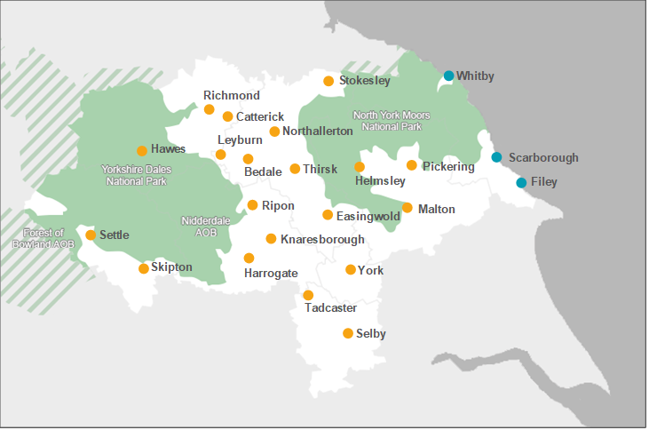





York & North Yorkshire – Snapshot
£28bn
Economy and home to York one of the highest performing cities in UK outside of London
1
of the most skilled and productive economies in the North
3214
Square miles – one of largest Combined Authorities covering urban, rural and coastal communities with a population of nearly 830,000
3
Universities and a world class science and innovation base
A diverse economy with a strong business base that is predominantly made up of micro and small businesses (98%)
Low unemployment and one of the strongest qualification profiles in the North conceals a dominance of low-skilled, low paid industries.
Wage levels are below national levels, particularly along the coast and in rural pockets, and a proportion of residents commute out of the area for jobs that are better paid
Constrained labour market - increasing rates of economic inactivity, ageing demographics and a decline in young people engaging in learning and work. Economic inactivity due to long-term sickness rose by 72.2% between 2019-2024
2/3 of employers have upskilling needs and 36% of employers have underutilised staff

Slide 20
Get York & North Yorkshire Working Plan
Priority | Actions | Priority Actions 2025-27
Supported Pathways for local people | Develop and deliver provision that is led by robust evidence and data. | Research findings from Trailblazer fed into wider programme development Identify cohorts/issues for further deep dives: rurality and accessibility, send & neurodiversity , Young people & graduates, Impact of AI and future proofing skills and jobs Develop standardised programme reporting and LMI dashboards
 | Develop and deliver person centred, holistic and place based support | Review and Evaluation of Trailblazer programme Launch of Connect to Work January 2026 Aligning employability support eg Trailblazer, Connect to Work, National Jobs & Careers Service
 | Align and utilise devolved skills funding and employment support | Explore joint commissioning model across CA programmes Joint work with LSIP on research into skills/qualifications for growth Evaluation of Skills Innovation Fund
 | Develop an all age approach to careers support | Continue work with partners as part of the YNYCA Careers Strategy group to develop a blueprint for an All Age Careers approach Strengthen relationships between Careers Hub, LAs and Local Jobs & Careers Service

Slide 21
Get York & North Yorkshire Working Plan
Priority | Actions | Priority Actions 2025-27
Enabling Good Work | Develop an Employer engagement and coordination strategy | Regular engagement with Business Board Inform and build on Trailblazer research into ‘employer motivations’ Promote and launch Careers Hub Collaboration Portal to support collaboration between employers, schools and colleges.
 | Simplify the work, health and skills landscape for employers | Launch and evaluation of Work, Health and Skills Interchange Model Identify and secure future operating and funding model
 | Support the work of the YNYCA Community Wealth Building Commission | Explore the role of anchor institutions, good work charters and social procurement in supporting employers and ‘good work’ (good quality and secure work). Ensure findings from Trailblazer research into Anchor Institutions and Good Business Charter inform the work of the Commission.
 | Support and promote Self employment as a route to becoming and remaining economically active. | Continue to develop programmes and resources to support self employment as a route to becoming and remaining economically active Strengthen relationships with Growth Hub, LAs and wider business advice professionals to promote self employment as an option

Slide 22
Get York & North Yorkshire Working Plan
Priority | Actions | Priority Actions 2025-27
Strategic Alignment and Collaboration | Provide system leadership through the development of a Shared Governance Model | Establish a GYNYW Steering Group (June 2025) Establish the Work, Health and Skills Forum Co produce a Shared Governance Model – Develop a logic model and an outcomes and metrics framework.
 | Provide system coordination, accessibility and navigation | Launch, test and evaluate the Work and Skills Interchange model
 | Integration of data, intelligence and research | Establish Shared Research Data and Intelligence Resource and Working group (July 2025) Explore opportunities and challenges presented by AI - future proofing skills and jobs
 | Development of strategic frameworks : Commissioning framework and Behaviour and Systems change approach | Co-design frameworks and implement across YNY Develop an outcomes and metrics framework to work across work health and skills provision and funding.
 | Strengthen Strategic Alignment across local, regional and national strategies and plans | 1. The GYNYW steering group will oversee and guide this work.
 | Build capacity and capability across the system | Establish Good Work, Health and Skills forum Continued support of Network development

Slide 23
Measuring Success
Get Britain Working Metrics – to support participation, progression, earnings and job quality.
Increasing the employment rate
Reducing health related economic inactivity rate
Reducing the disability employment rate gap
Reducing the proportion of 18 to 24 year olds not in education, employment or Training
Reducing the employment gaps among parents aged 18 to 66
Increasing the female employment rate
Real earnings amongst non-retired households
Local work in progress…
Looking to develop local indicators
Align with our local ambition and with key strategic plans
Reflect the areas challenges, demographics and priority cohorts
Develop logic model and outcomes framework

Slide 24
Next Steps
  This is the first edition of the plan.
  A more detailed delivery plan will be produced in March 2026
  The Plan will be reviewed in June 2026

Slide 25
YNY Economic Inactivity Trailblazer: ‘Test & Learn’
Year 1 2025-26: £10M
3 Overarching Priorities:
  Engaging and Supporting people
  Good Work – supporting employers
  Joining up systems and services
28 Delivery projects
10 Data and research projects
Mixed delivery model
In house, grants, procured
Key Partners: NYC, CoYC, ICB, Better Connect – includes range of local delivery partners
Engaging & supporting people
£4.3M
Joining up systems & Services
£2.5M
Good Work (supporting employers)
£3.2M

Slide 26
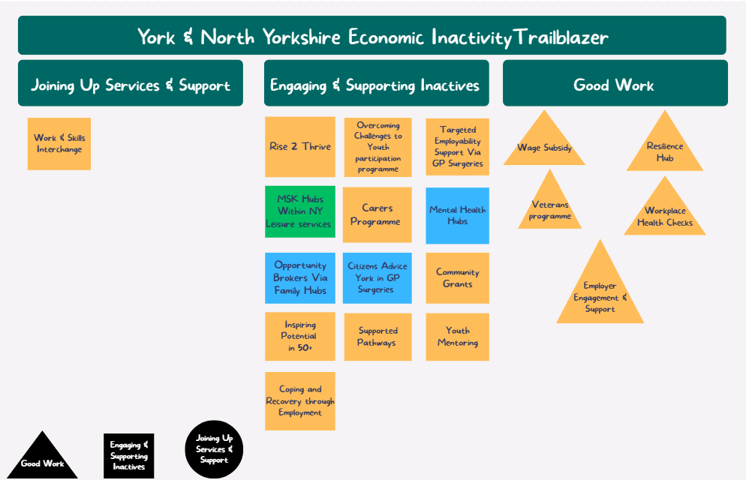
Interchange Navigator Network and Training
Community engagement and outreach
Work & Skills Interchange
Interchange Advisers for individuals and employers
Interchange web platform
Integrating data and research projects
Yellow – Across YNY
Blue – York only
Green – North Yorkshire only

Slide 27
YNY Economic Inactivity Trailblazer: ‘Test & Learn’
Year 2 £10M 2026-27
3 Overarching Priorities:
  Engaging and Supporting People
  Good Work – supporting employers
  Joining up systems and services
6 workstreams:
  Place based engagement and support model
  Integrated co-located health & employment support
  Employer Support Programme (inc financial incentives)
  Work & Skills Interchange/Coordinated point of access model
  Bespoke pilot provision
  Integrated data and research
Engaging & supporting people
Joining up systems & Services
Good Work (supporting employers)

Slide 28





Rise2Thrive Trailblazer: Delivering Change in York & North Yorkshire
Holistic, person-centred employment support

Slide 29


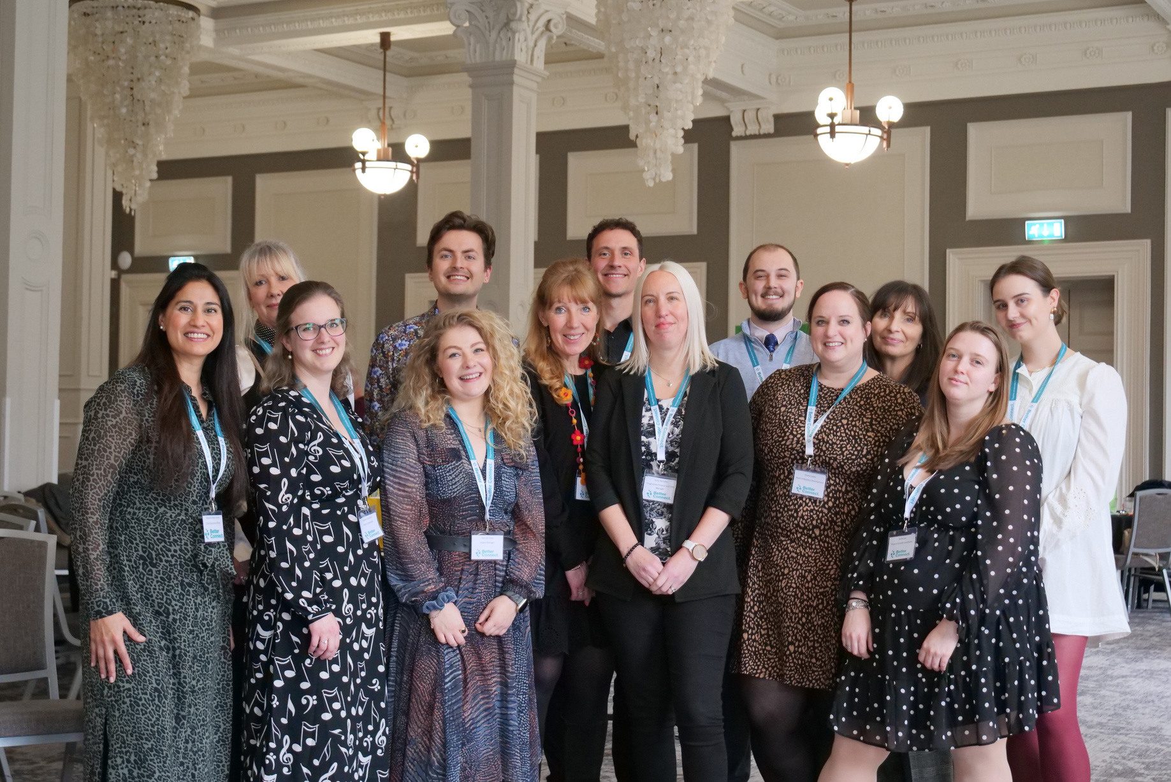
What we do
For almost two decades, we have connected funders, businesses, and VCSE organisations by designing and leading partnership programmes that create better lives
Our Mission
Together, we can create a Yorkshire where every person is empowered to thrive in life and work

Slide 30


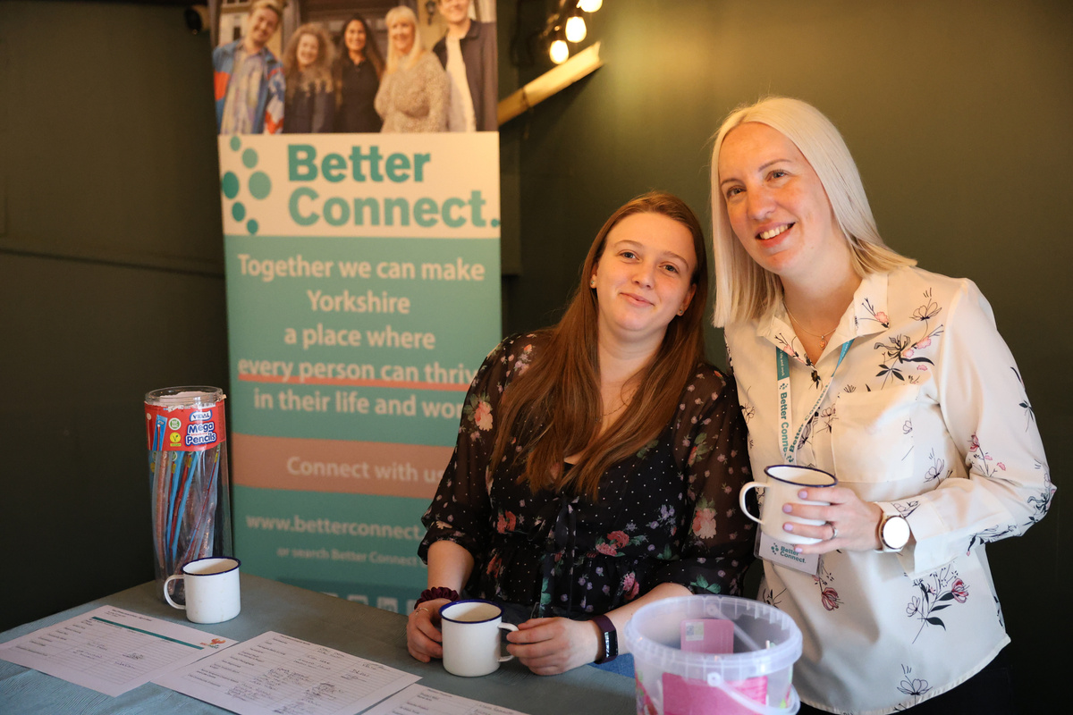
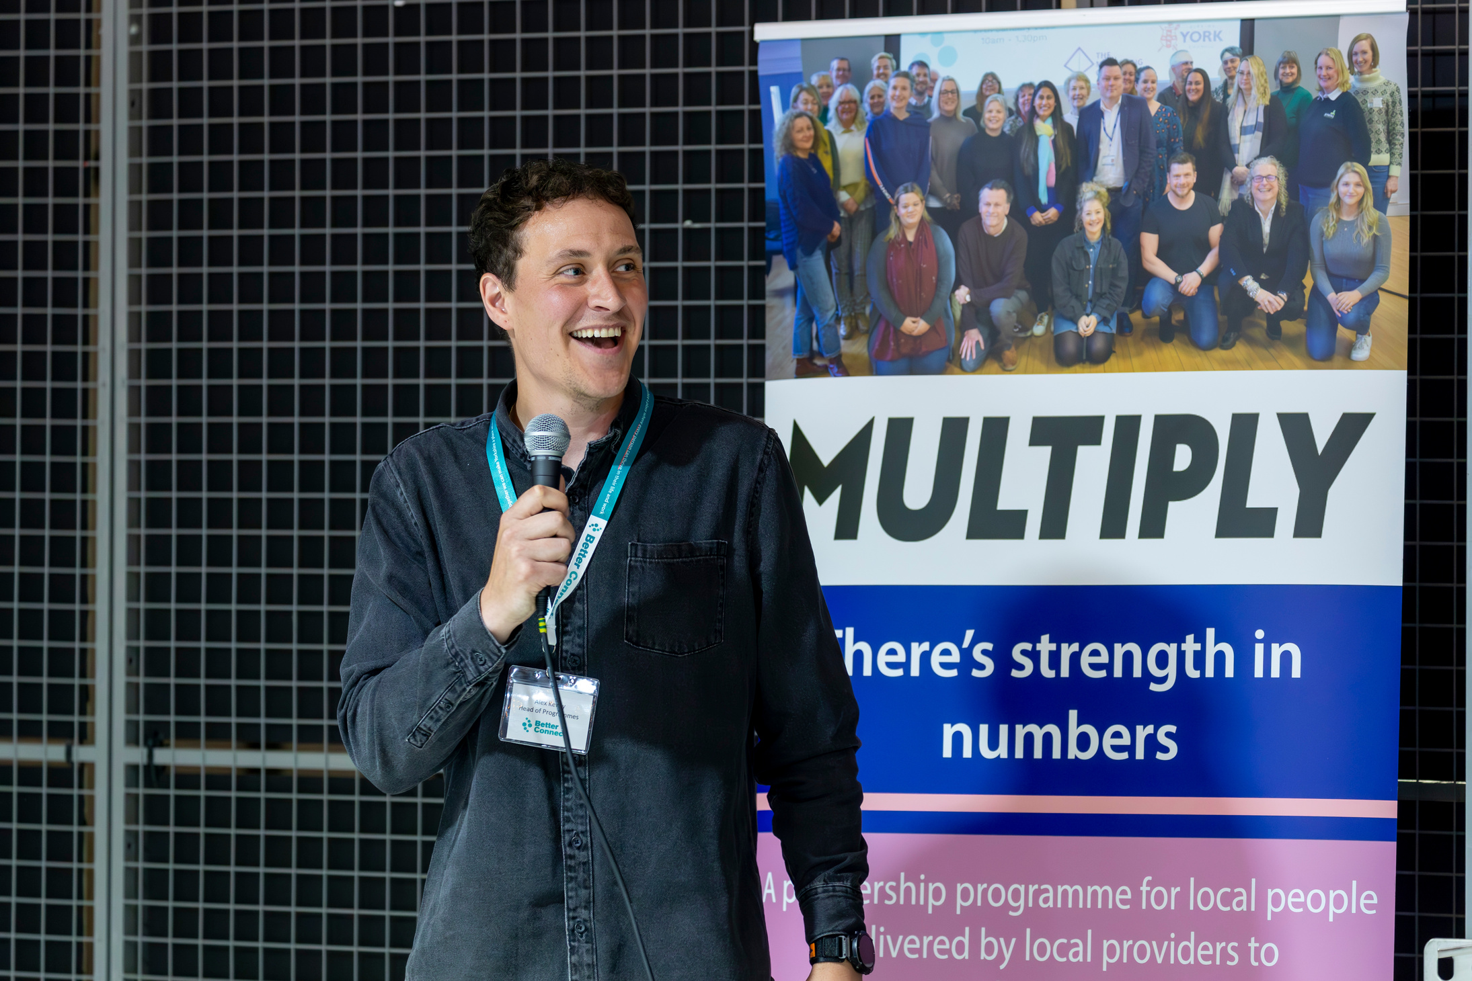


Track Record
Led partnerships with 200+ local organisations
Managed over £40 million in funding and social investment
Supported over 20,000 participants
across key programmes
Delivered over 40 programmes across Yorkshire
20 years of experience

Slide 31



LSIP 2023 HIGHLIGHTS PEOPLE NEED HELP OVERCOMING BARRIERS TO WORK.
York & North Yorkshire

Slide 32









































How it Works

Slide 33
The Partnership
  35 strong (primarily VCSE) partnership led by Better Connect
  Different expertise & specialisms
  Spread across 8 regions: Harrogate, Hambleton, Ryedale, Richmond, Craven, Scarborough, Selby, York
  Quick to mobilise
  Strength in numbers

Slide 34

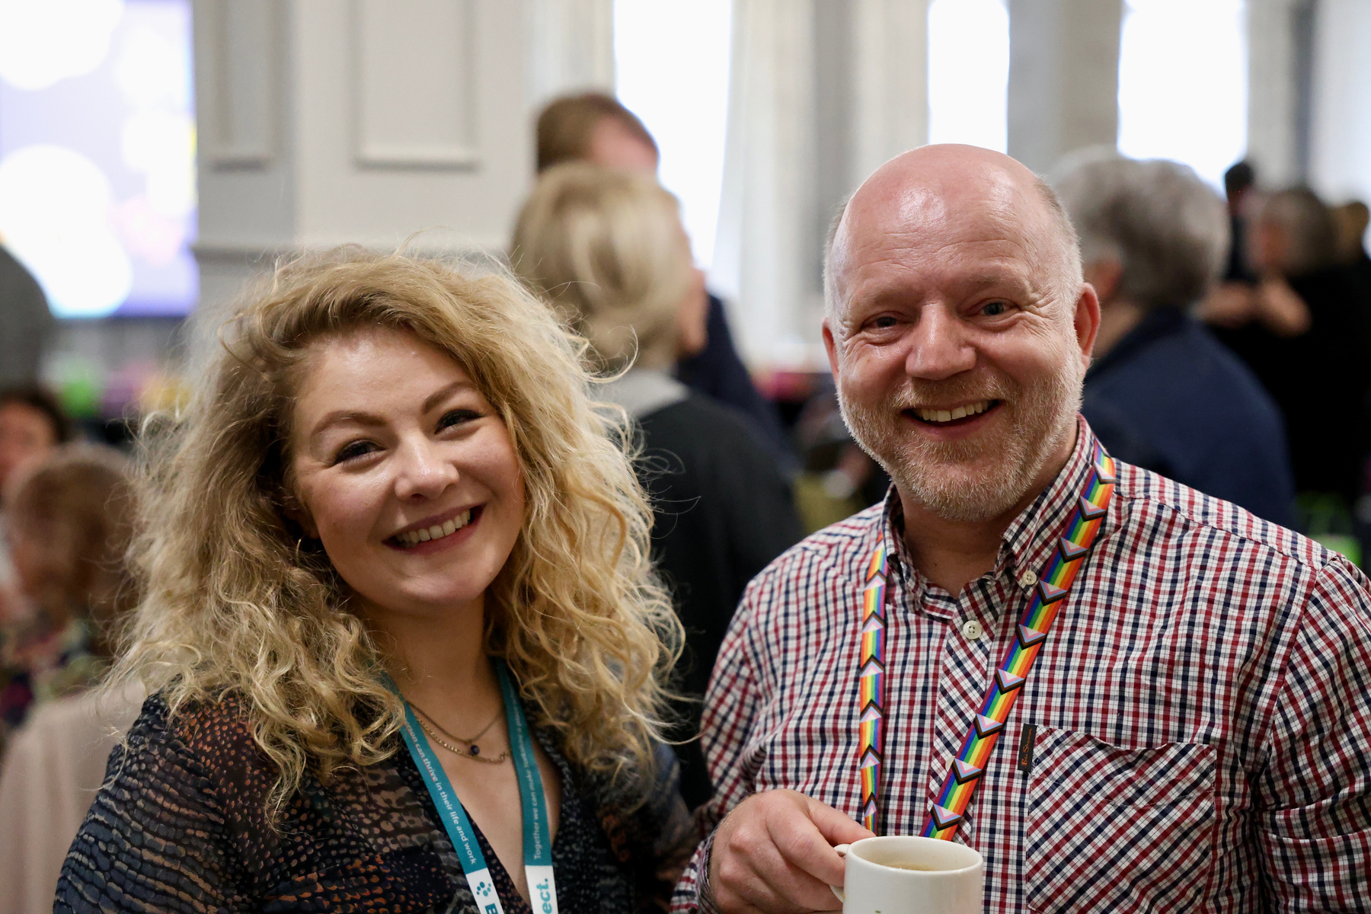
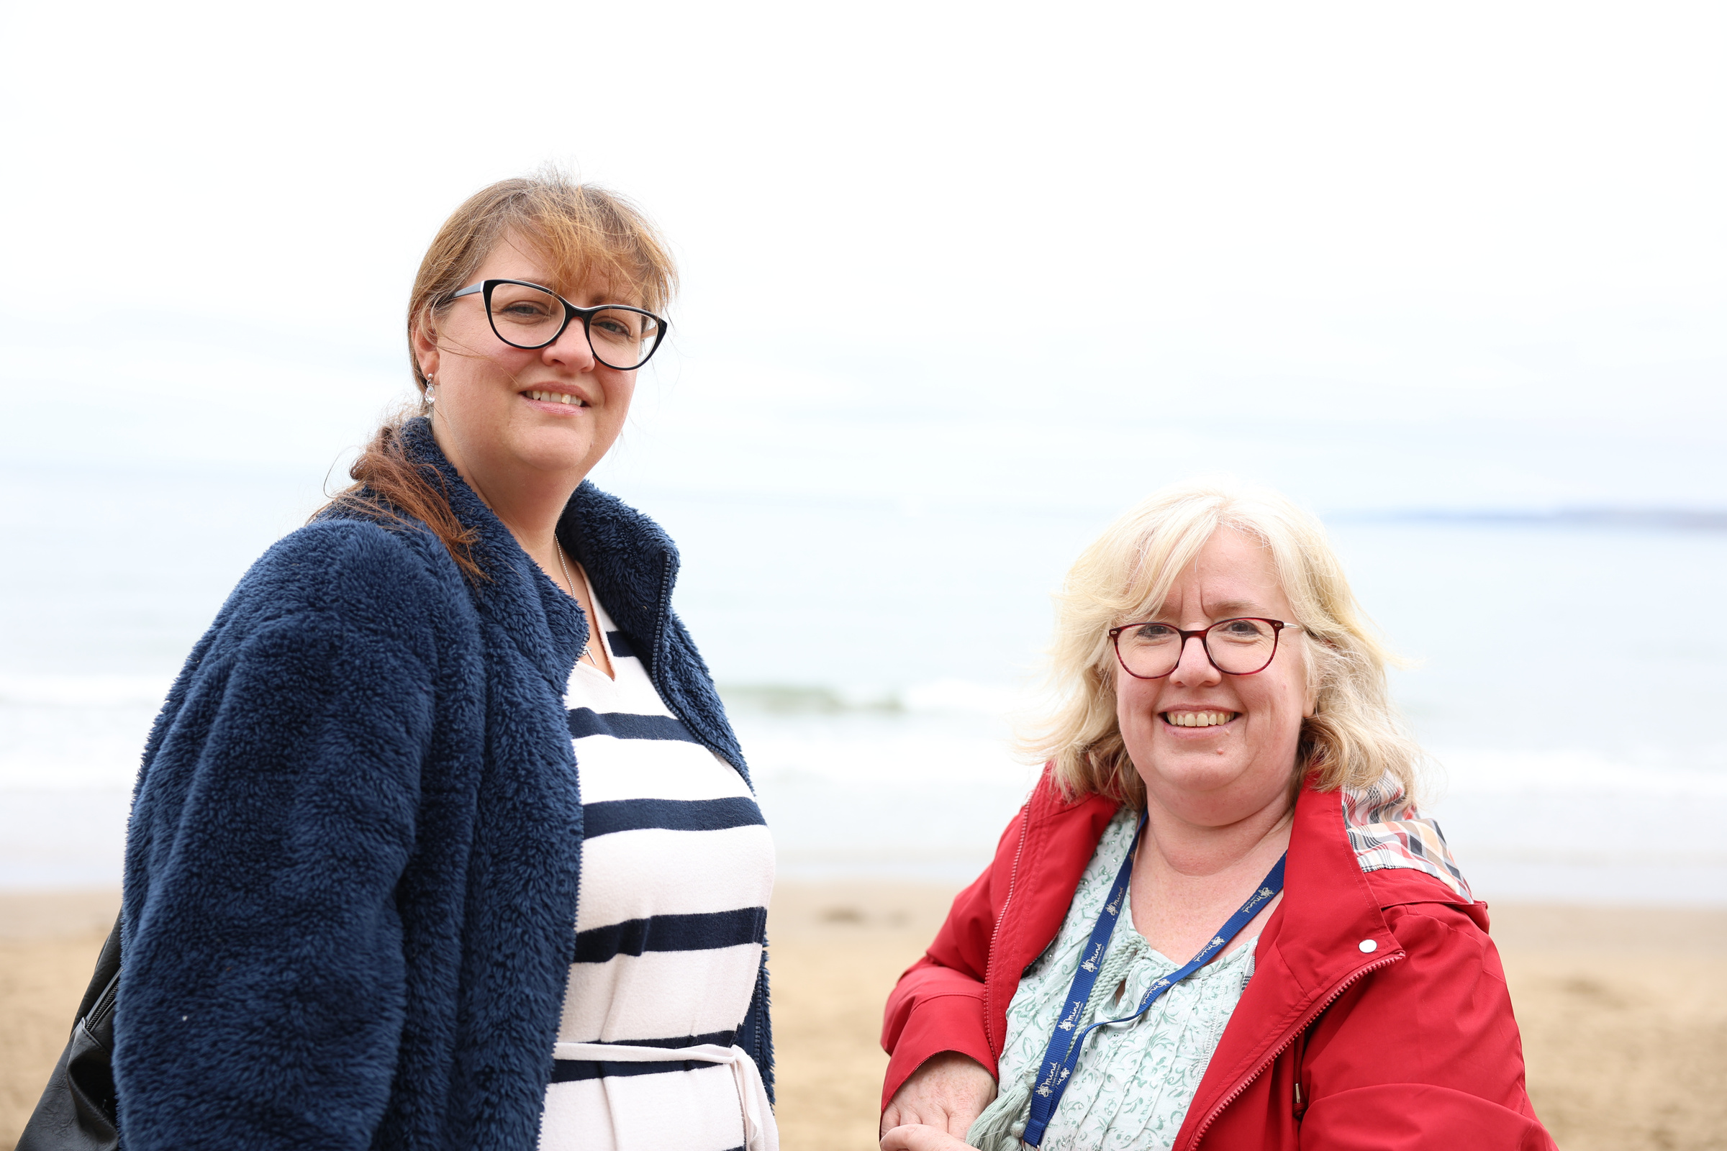
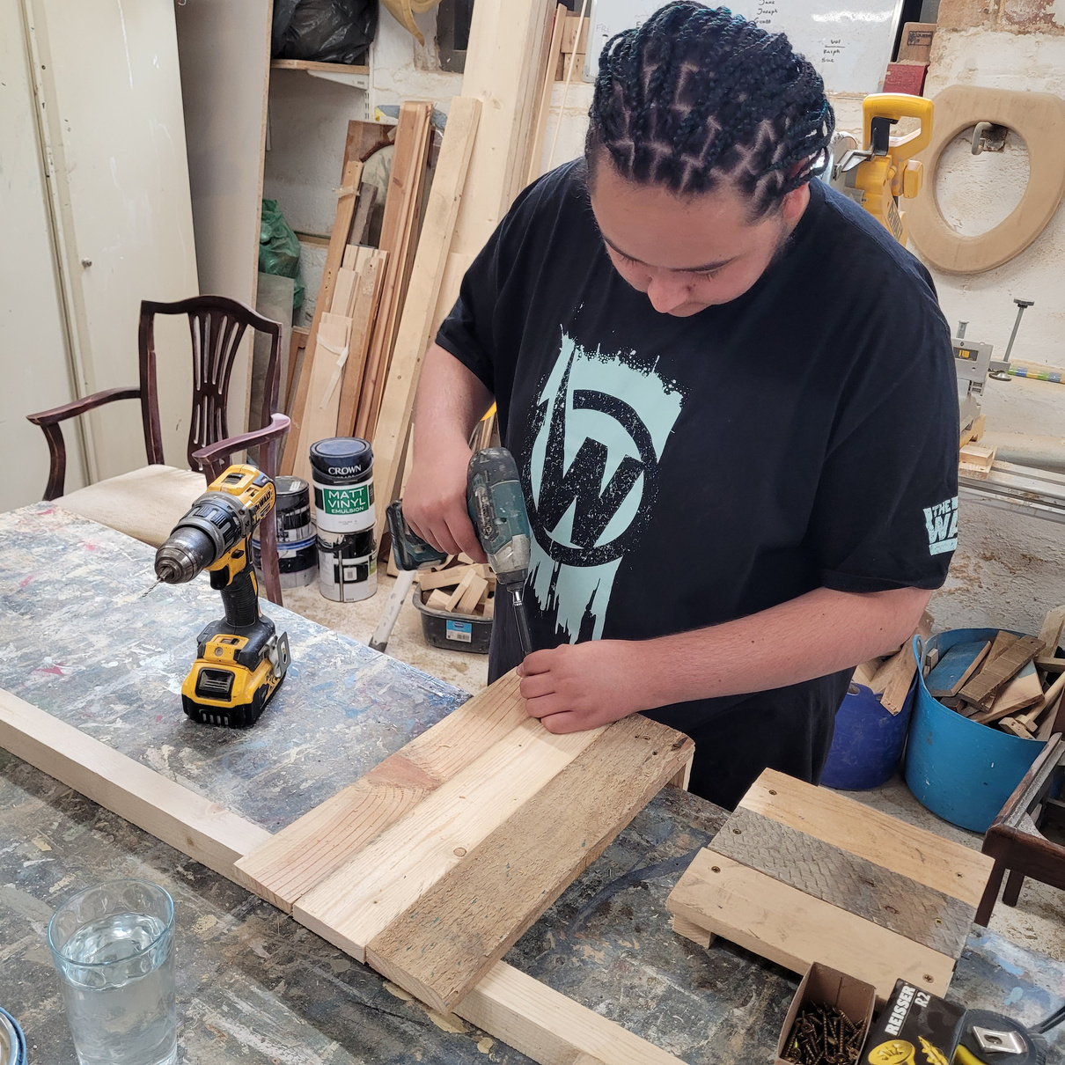

Why person-centred support?
Participants with 4 or more complex barriers
50%
People supported via person-centred employment programmes since 2017
6,786
“It has allowed me to gain the qualifications and confidence to go to college. Without Futureworks I would not have done this.”
Participants progressing into work, training or education
44%
“It’s helped me find work.”

Slide 35
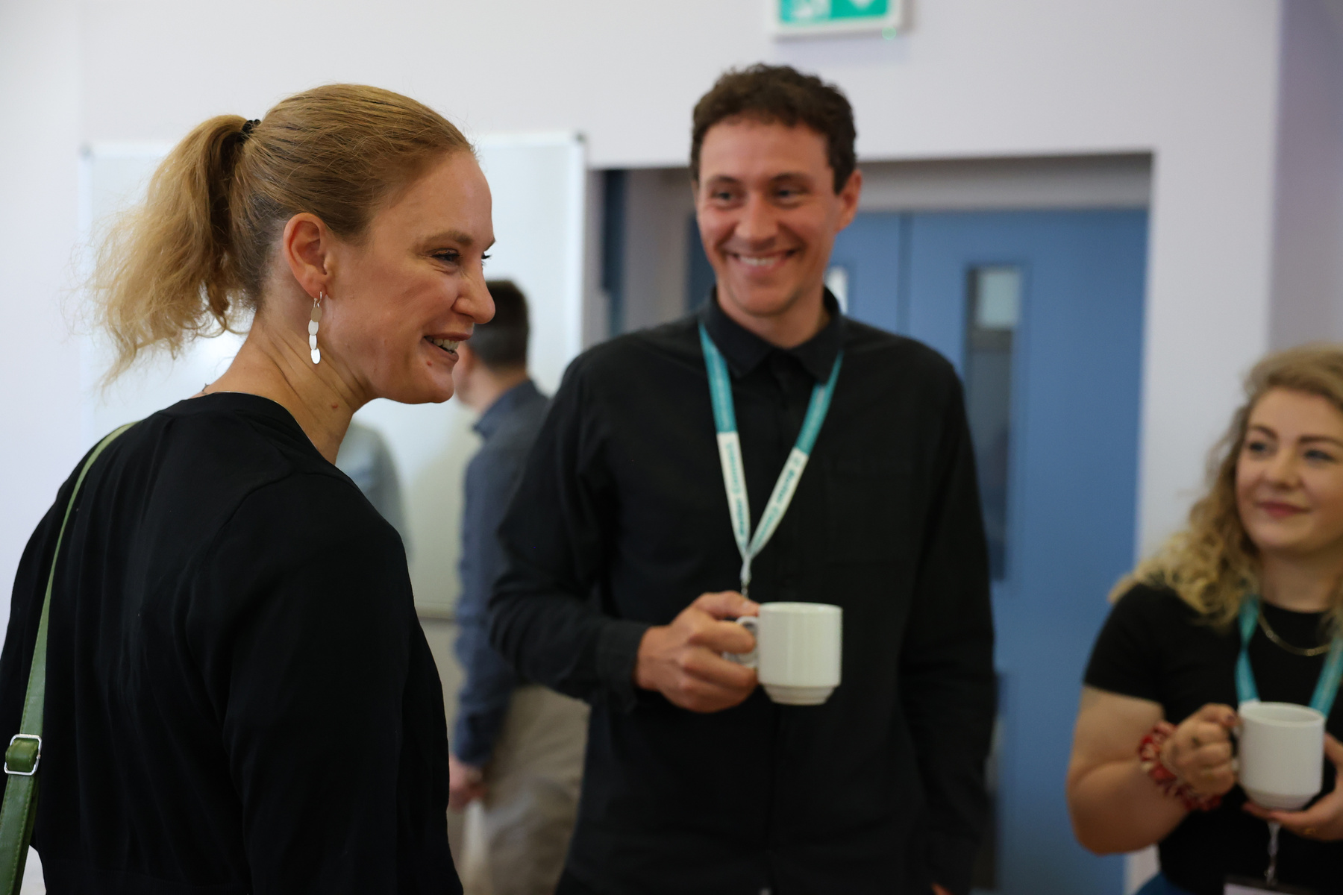
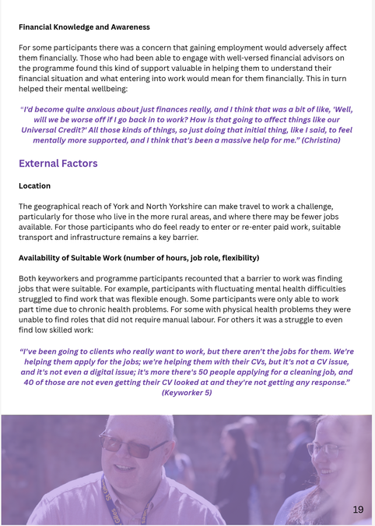
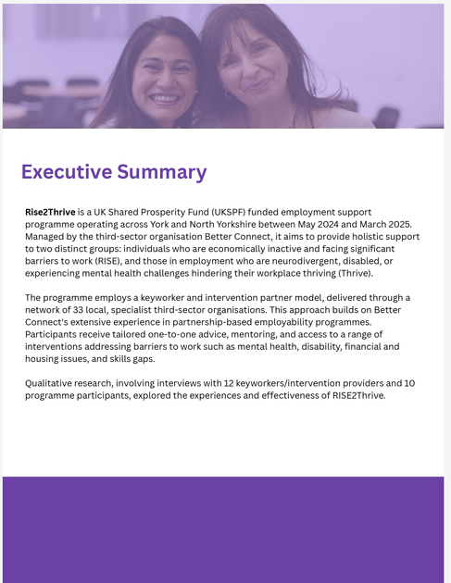






Why the model works:
Dr Jane Suter & Dr Tina Kowalski
  “A key strength of Rise2Thrive Trailblazer, is the person centred approach to support (...) participants valued how the programme was tailored towards their own needs and paced accordingly (...) in stark contrast to other support services.”
  “With ever more demand, and ongoing de-funding or fragmentation of other support services, the support provided by programmes such as Rise2Thrive Trailblazer is invaluable in terms of progressing participants along their journey towards entering, or sustaining paid employment”
  “Despite the complexity of participants' barriers, Rise2Thrive achieved significant outcomes, including improved confidence, inclusion, belonging, and peer support, as well as enhanced wellbeing. Participants reported feeling more supported, less isolated, and more connected.”

Slide 36
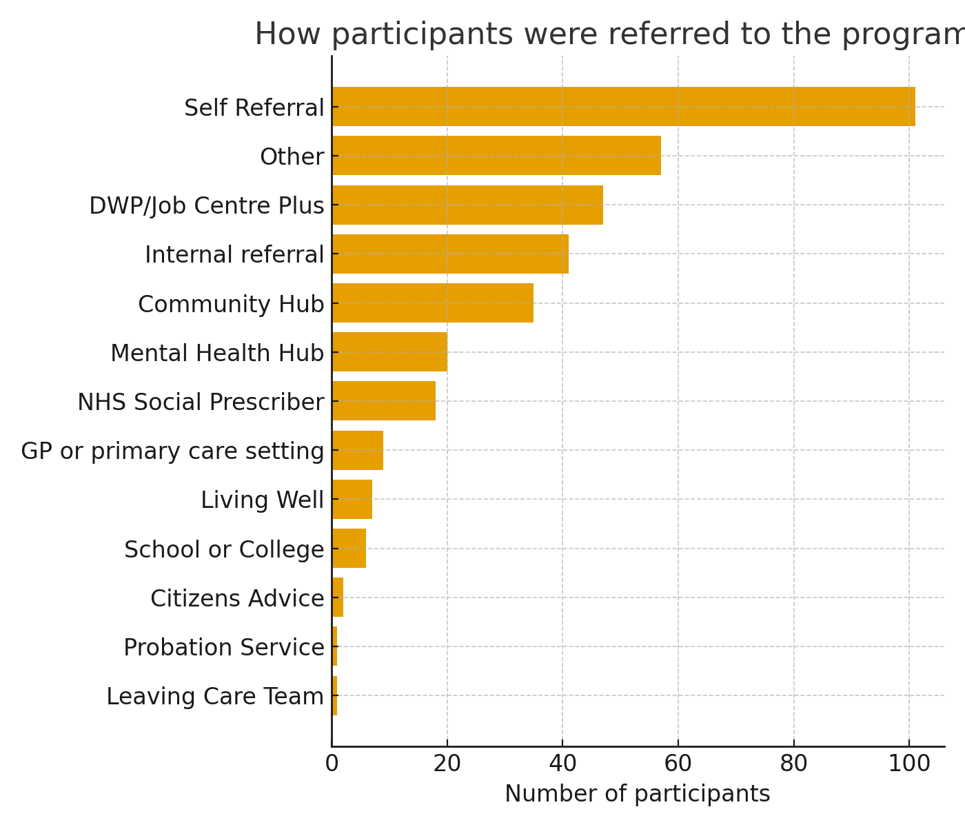
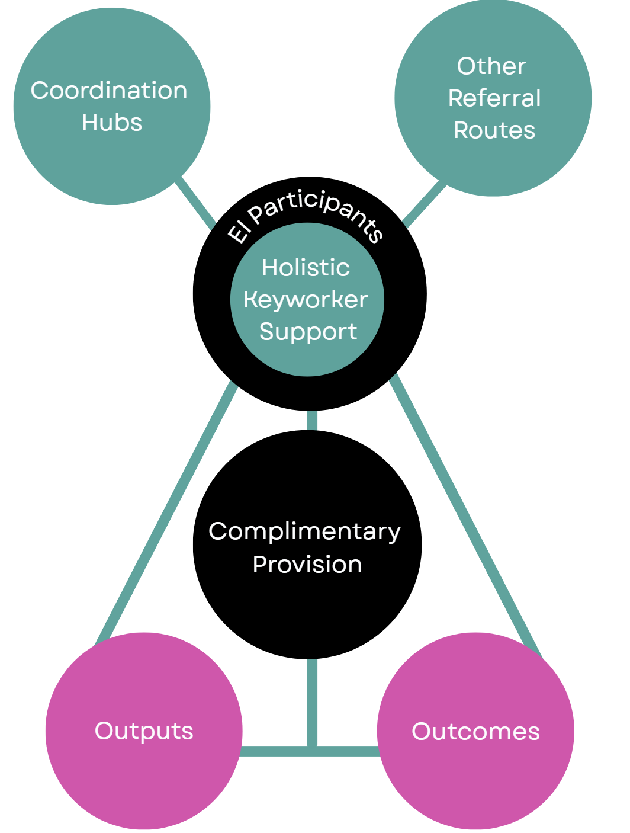
Trailblazer Model

Slide 37
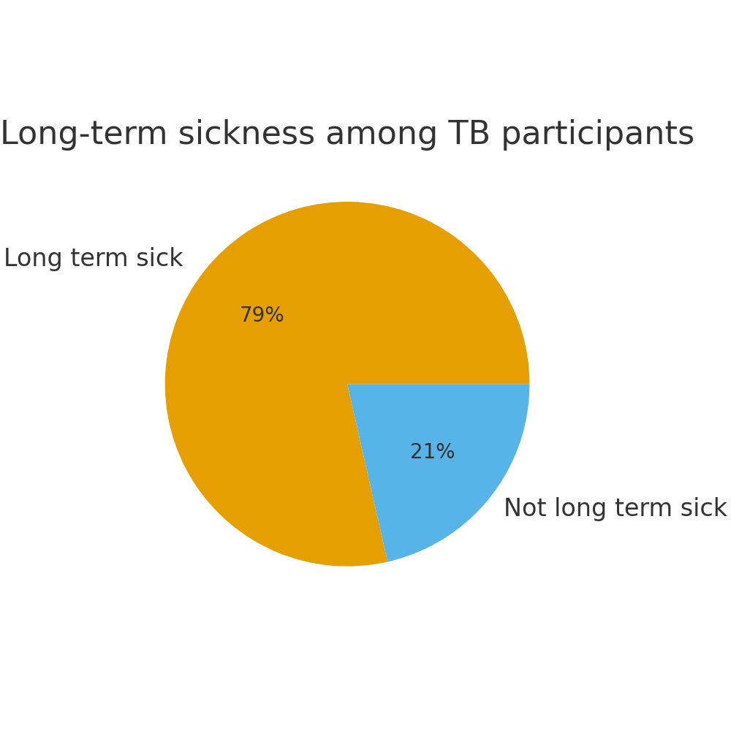
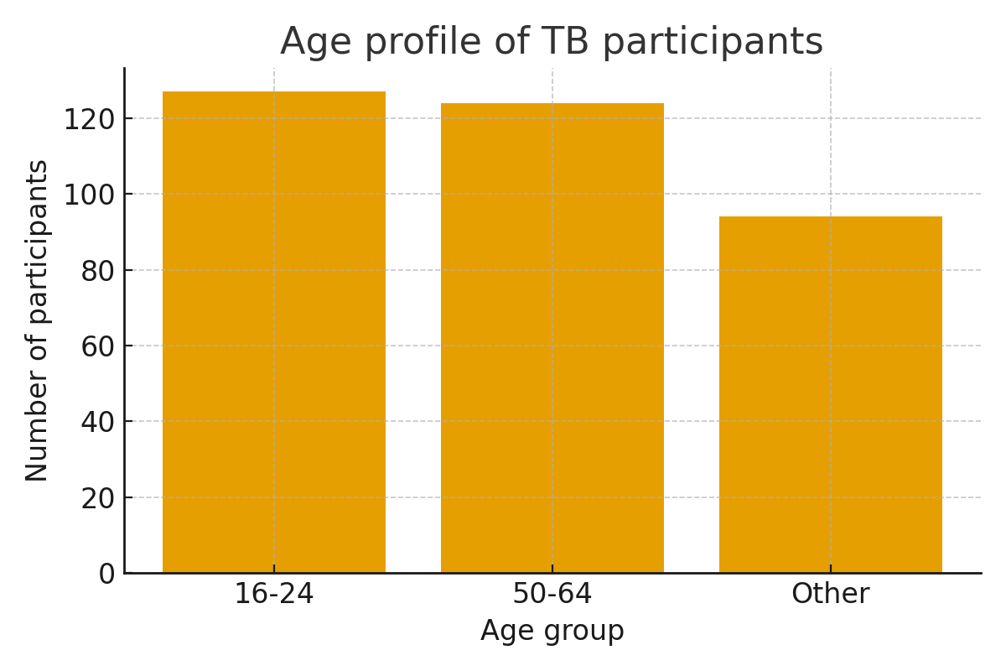
Insights - programme data so far (delivery began in May 2025)
Trailblazer participants to date – 345/500
(Rise2Thrive participants to date – 753/870)

Slide 38
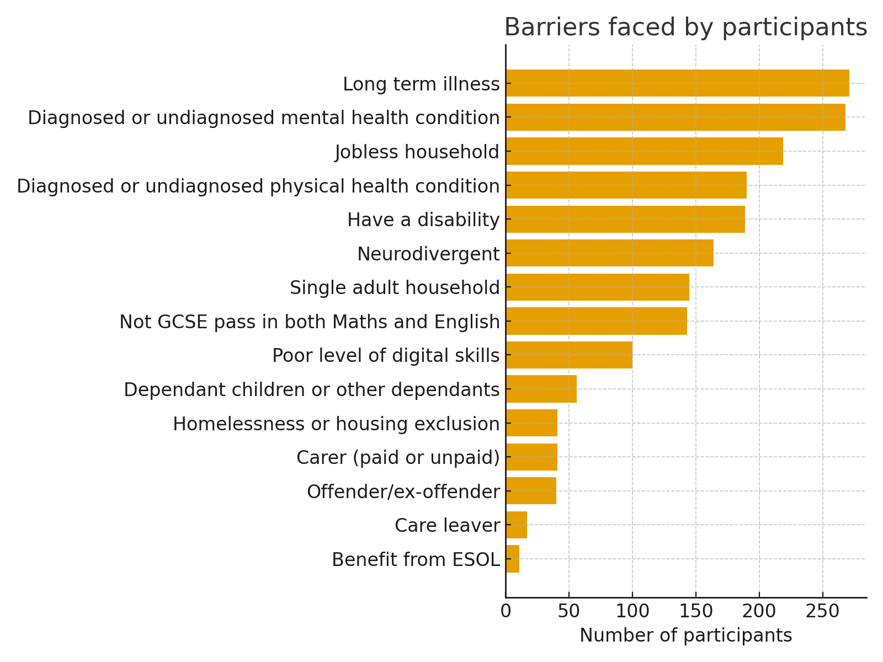
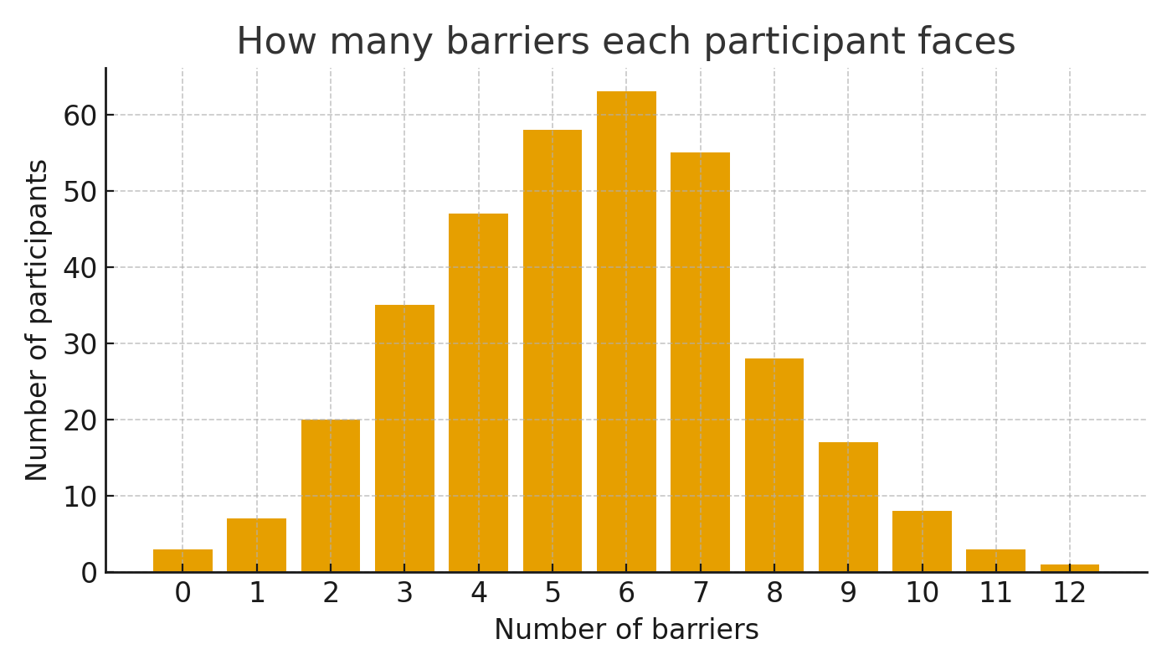
Insights - programme data so far (delivery began in May 2025)

Slide 39
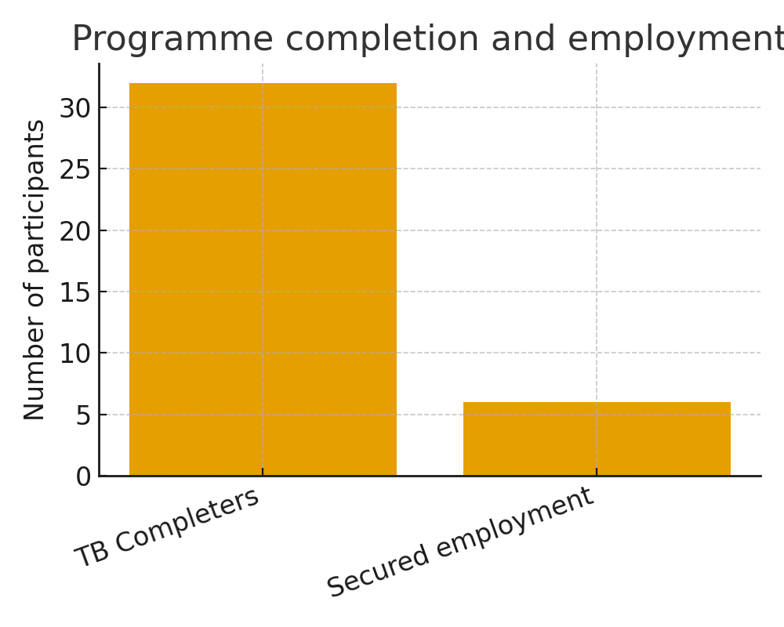
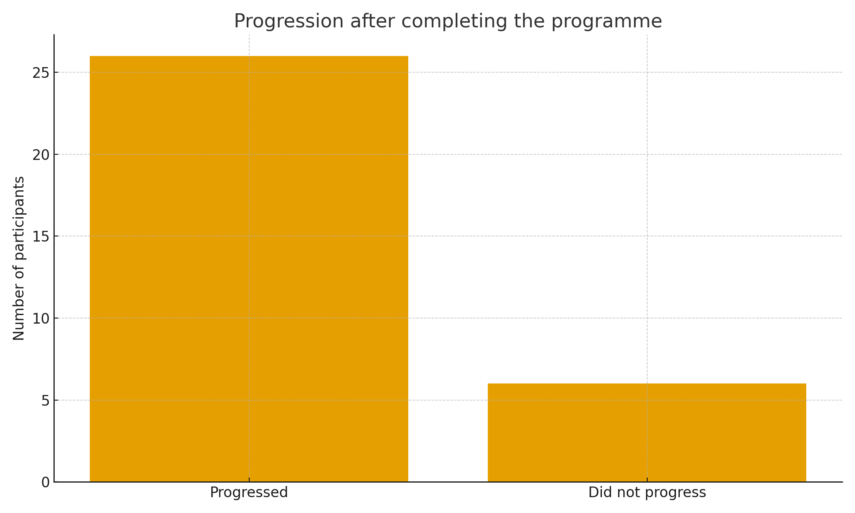
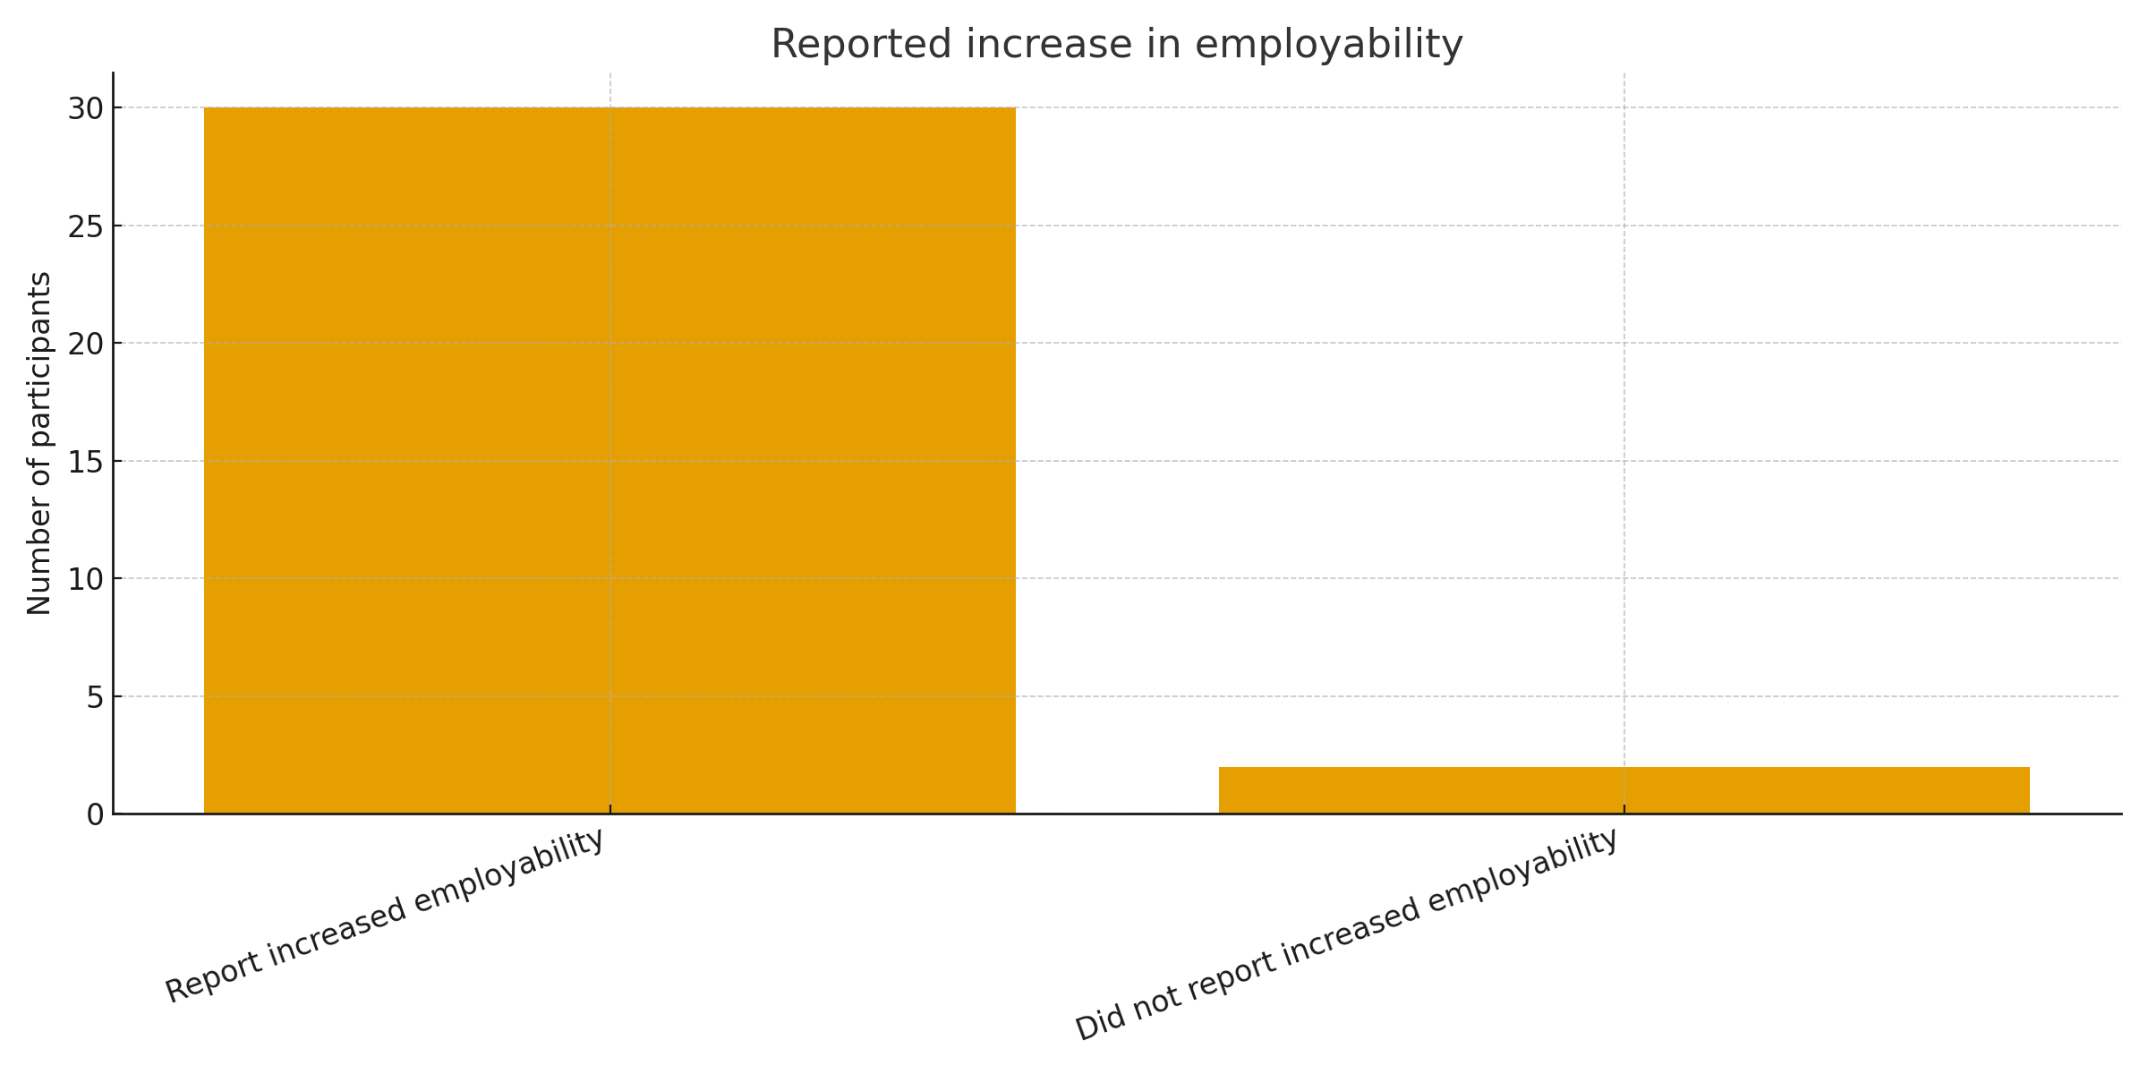
Insights - programme data so far (delivery began in May 2025)

Slide 40



Wage Subsidy
Joining-up
Support
  3 month work placement
  Builds confidence, skills and experience, often after years of economic inactivity - ready for employment
  Possibility of role at end of placement
Secure
Employment
Trailblazer Community Grants
Rise2Thrive Trailblazer
  Participants secure long-term employment
  Opportunity to engage with ‘Thrive’ element of Rise2Thrive Trailblazer, accessing in-work support to sustain and progress in work
  Less strain on public & healthcare services - contributing to local economy
  First steps engagement
  Pre-employment support; building confidence, skills, readiness for work
  Primed for next steps engagement - Rise2Thrive Trailblazer
  Holistic, whole-picture employability support
  Addresses participant barriers, improving skills, opportunities, and employability
  Primes participants for Wage Subsidy Programme, work, & workplace progression

Slide 41
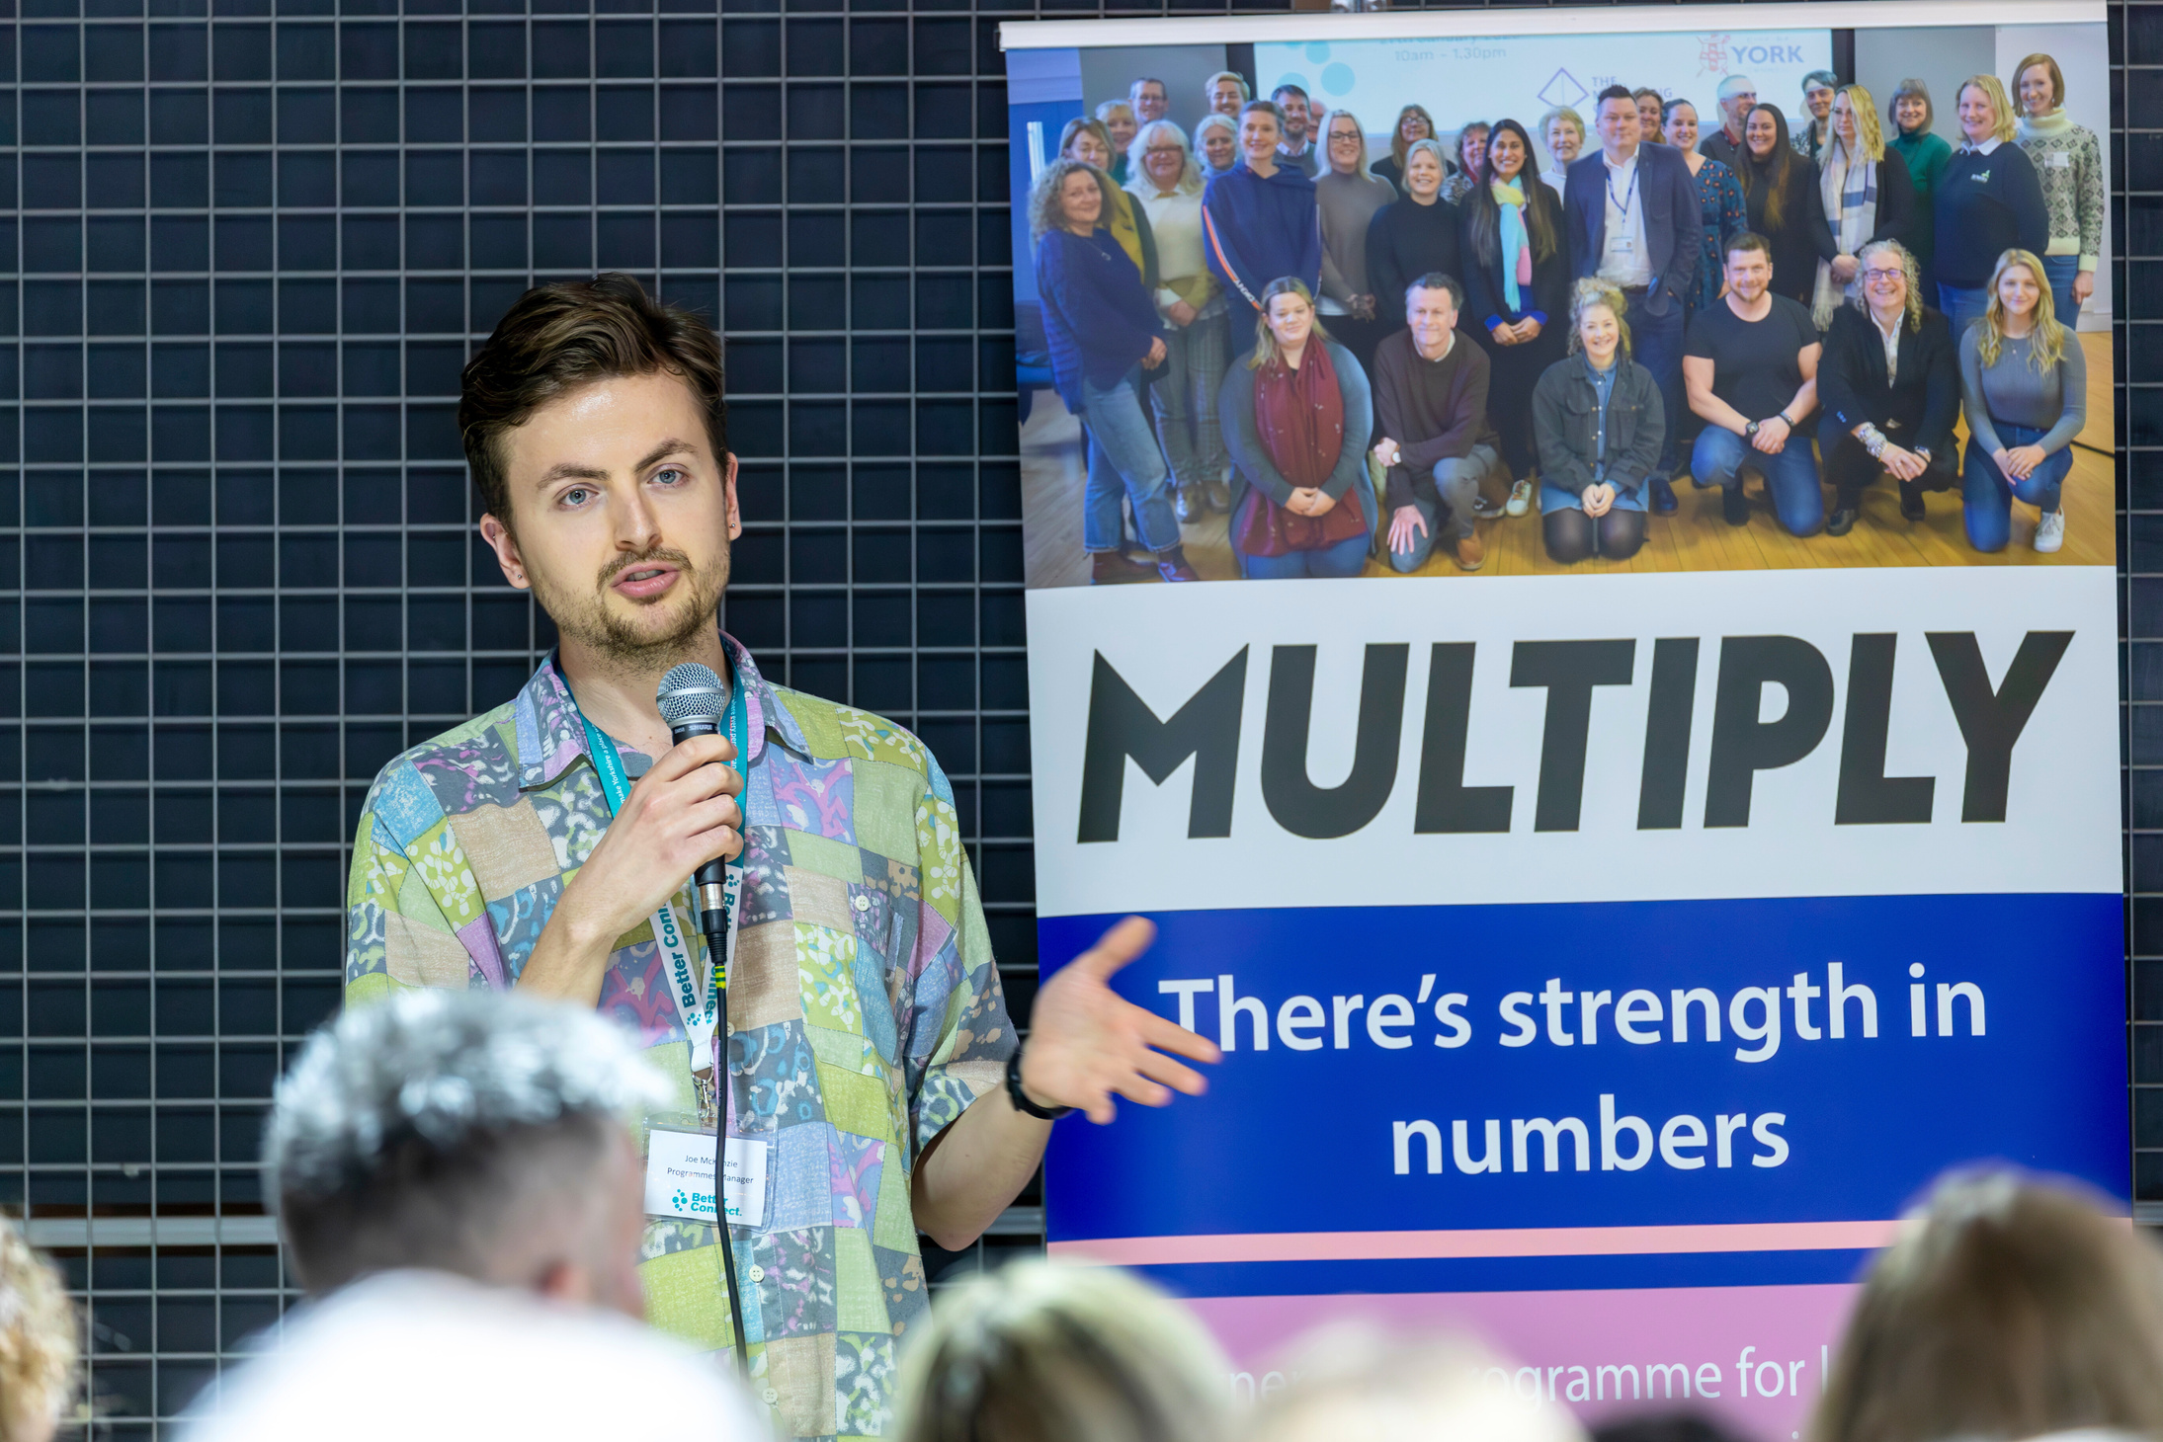


What have we learned
VCSE Sector as an Equal Systems Partner
The voluntary sector has the ability to move mountains and affect lasting economic change
Better Together
Together, we can maximise investment, mobilise quickly, and extend our reach
Person-Centred Support
We must rethink employability: longer-term holistic support drives lasting impact and builds sustainable futures

Slide 42

Leanne’s story - Rise2Thrive Trailblazer

Slide 43

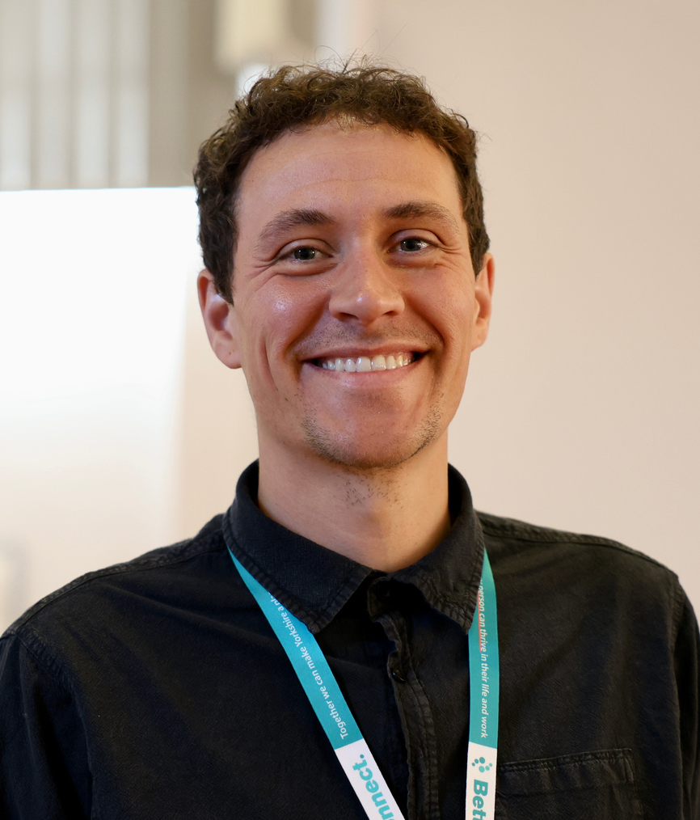

Connect with us
Natasha Babar-Evans
Chief Executive
Officer
nbabarevans@betterconnect.org.uk
Alex Kelley
Director of
Programmes
akelley@betterconnect.org.uk
Emma Lyons
Head of Business
Development
elyons@betterconnect.org.uk
Hannah Prole
Head of
Impact
hprole@betterconnect.org.uk

Slide 44
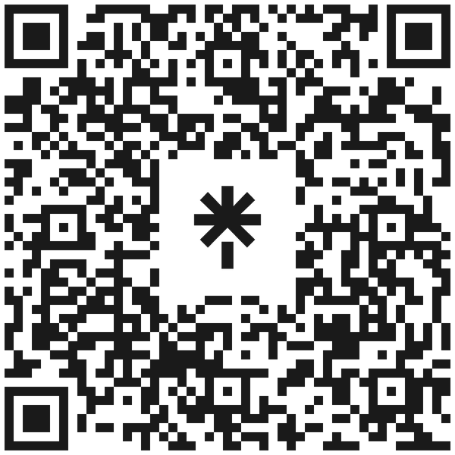

Thank you for your time
Scan me to find out more!

Slide 45

“All roads lead to the Interchange…...”

Slide 46
So, what exactly is the Interchange?
The Interchange is all about connection. Its purpose is to link individuals and employers to the work, health, and skills support they need—bringing together services and the people who can benefit from them.
During the Trailblazer phase, we’re testing the concept and building a model that’s fit for purpose and ready to roll out from 2025/26 onwards.

Slide 47
How does it work?
We’re making access as easy as possible by removing barriers. Whether you prefer speaking to someone directly or sending an email, our helpdesk is here for you. Every query is triaged and directed to the most suitable support—no more endless Googling.
So you can call us to speak directly to real person – or if you prefer you can email us.

Slide 48
Coming soon…. (promise)
A brand-new, fully accessible website packed with up-to-date information. You should be able to find what you need here.
Our Central Knowledge Hub—a smart, searchable directory of support and services that grows every day.

Slide 49
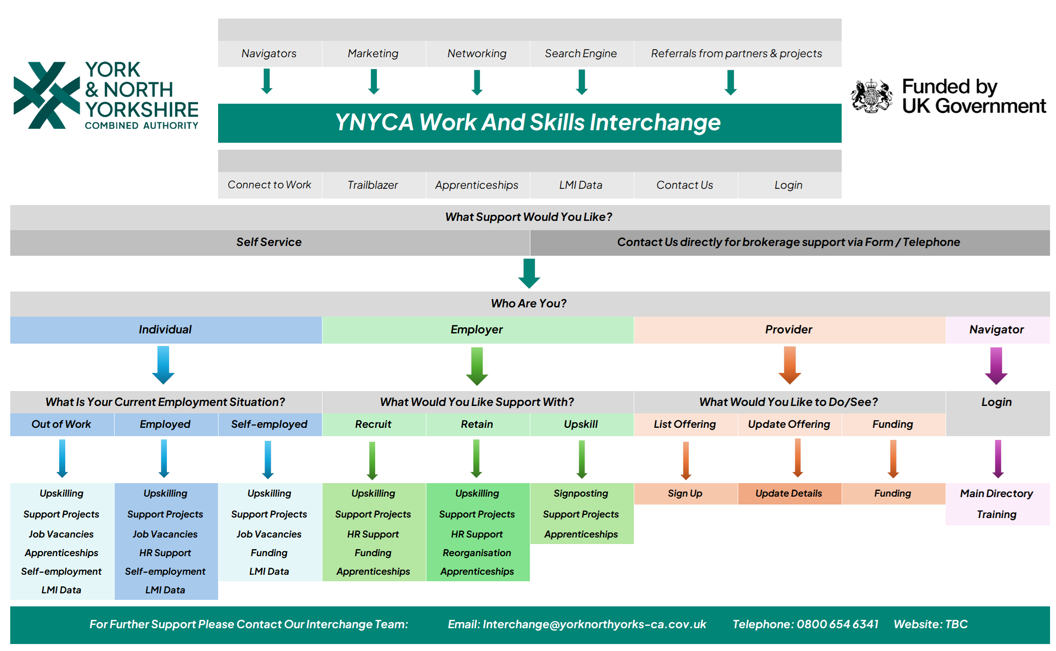

Slide 50
Navigators. What are they?
‘Navigators, based in third party organisations who already have existing contacts with individuals / employers who could benefit from work, health and skills support. Focused on individual support.
These Navigators will be/are being trained. Together they start to form a giant network of professionals across the entire region, all working through the Interchange, finally joining up provision.

Slide 51


The Employer Support Programme
Dedicated members of the team to engage with Employers who play a vital role, in creating good work opportunities, and reducing current and future economic inactivity. The Employer Support Programme aims to support our York & North Yorkshire employers to build their capacity to create inclusive job opportunities that the region’s residents need.
Employer Support Programme Providers:
Growth Planner Co.
Pro Development UK Ltd
The Innate Coach Ltd
Curious Edge Ltd
Flying Futures CIC
Your Small Business Board Ltd
People Savi Ltd

Slide 52
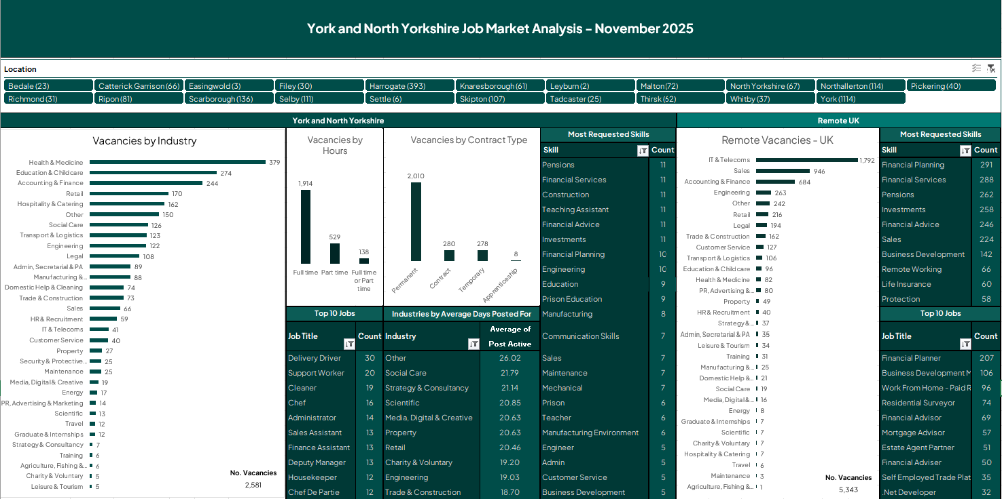

Slide 53


YNYCA Work and Skills Interchange
Freephone : 0800 6546341
Email: interchange@yorknorthyorks-ca.gov.uk

