Slide 1
Get York and North Yorkshire Working Economic Inactivity Trailblazer Programme 2025/26
North Yorkshire Council Programme outline
Project Spotlight – MSK Hubs
Angela Crossland, Head of Service Public Health, TB Programme Lead
Ian Salvin, Active North Yorkshire, Community Health & Well-Being Lead

Slide 2
North Yorkshire Programme Outline
Up to £4,171,404 programme
17 projects
Supporting 1431 inactive individuals, 349 in work 'at risk' and 190 businesses to enhance employment support
Focus on 16-25 years and 50-64 years
Focus on carers, veterans, insights into neurodiversity, early retirees
Delivery Principles
Build on existing projects
Mobilise quick routes to market
Develop pilot and test activities to inform future service development

Slide 3
Trailblazer projects
The programme consists of 17 individual projects that fit within the overall priorities as follows::
Engaging and Supporting Individuals
Supported Pathways | Supporting inactive people to volunteer through personalised action plans, training opportunities, 1:1 support | Hambleton Community Action
Overcoming Challenges to Youth Participation 14-25yrs | Work in schools and with parents and carers of 14-16yr olds at risk of long-term NEET and an enhanced employability support programme for 16-25yrs with EHCP and additional employability barriers | NYC Adult Learning
Youth Mentoring | School mentor support for Yr 10 pupils in YNY. Up to 60 pupils at risk of long term NEET | North Yorkshire Youth
Inspiring Potential in 50+ | Maintaining or returning 50+ in employment. Mentor support | NYC Adult Learning
Carers Programme | Job match, training, backfill and support to stay in or return to work and advice to employers/businesses | Carers Plus Dementia Forward
Veterans | Improve employment pathways and support for veterans | North Yorkshire Sport
MSK Hubs | Lifestyle interventions through Active North Yorkshire to reduce health condition barriers to work and reduce sickness absence rates | Active North Yorkshire
Community Grants | Small grants scheme to VCSE up to £25k per project to target priority groups/economically inactive. Pilot projects | Better Connect

Slide 4
Trailblazer projects
The programme consists of 17 individual projects that fit within the overall priorities as follows::
Good Work
Workplace health checks | Employer engagement in developing workplace health and providing NHS health checks | NYC Public Health
Active Well-Being Workforce Development | Build workforce capacity to engage inactive people with health conditions | North Yorkshire Sport
Employer engagement (levels 1-3) | Wraparound education and conference model to engage and develop businesses | NYC Economic Development
Employer Support | Target 6 businesses with specific employment challenges and support with OH and specialist HR support to improve inclusive recruitment and retention practices | NYC Economic Development
Wage Subsidy Scheme | Wage subsidy programme to support 3mths, 16hrs pw FTC placements with businesses | NYC Human Resources

Slide 5
Trailblazer projects
The programme consists of 17 individual projects that fit within the overall priorities as follows::
Joining Up Services and Support
Place Based Engagement | Public campaigns to understand 'good work' focused on specific demographics (high inactivity areas, 50-64yrs and veterans) and campaigns in schools | NYC Adult Learning
Place Based Navigators | Network coordinators in health, business and VCSE organisations developing communities of practice and training in Local Area community hubs | NYC Adult Learning
Health Data Analysis | Joint NYC, CYC and ICB resource commissioned by YNYCA to develop a data intelligence approach to identifying target populations for support with health and employability | NYC Strategy & Performance HNY ICB
Behavioural Insights into Economic Activity | Behavioural Science resource commissioned by YNYCA to survey and gather research from early retirees (50-64) in rural areas | NYC Public Health
Funding also includes 4% management and administration fees

Slide 6
Who is Active North Yorkshire?
Active North Yorkshire delivers health and wellbeing services through 26 health and well-being centres offering universal services such as swim, gym, classes and community sports.
But did you know….
Our comprehensive range of programmes includes:
Helping people better manage long-term health conditions and their symptoms
Supporting strategies and tools to help with low to moderate mental health conditions
Supporting diet and lifestyle behaviour change
Collaborative programmes with the NHS for cardiac, and pulmonary rehabilitation, and prehabilitation and rehabilitation for people with a cancer diagnosis.
This now includes the Harrogate and Selby Trailblazer MSK Hubs!

Slide 7
So, what is a MSK Hub?
A 12-week rehabilitative exercise intervention to enable people to better self-manage musculoskeletal issues or injuries that:
Currently prevent them from working at all
Lead them to be frequently absent from work, or unable to do their normal duties, or
Cause them to be less productive at work because of impaired mobility, pain and/or discomfort
The MSK Hubs are delivered by specialist instructors, who:
Individually assess referred participants, using ‘best practice’ screening tools and questionnaires
Design personalised rehabilitation programmes to enable them to get back-on-their-feet, sometimes literally, and able to return to work.
Programmes may utilise specialist-led exercise classes, appropriately designed gym programmes, specialised exercise equipment, and aquatic therapy

Slide 8
Where we are currently:
Marketing displayed throughout Harrogate and Selby
Promoted to colleagues within NYC
Promoted to over 80 businesses and employers
Promoted through existing partnerships with primary and secondary NHS healthcare professionals
MSK Hubs launched w/c 13/10/2025
Currently >30 participants across the two MSK Hubs
20 new participants booked for next two weeks
Main referral routes thus far have been:
Self
GP Surgeries
Harrogate NHS Physiotherapy Dept.
……Emerging impact stories look very positive!

Slide 9
MSK Hubs - Next Steps
Continue to build participation and engagement
Confirm impact measures
Continue development of service with employers
Explore further opportunities with health colleagues, i.e. ‘joining up’ data to support improved year 2 delivery

Slide 10
NY Programme - Next Steps
Year 2 – Reflect, Focus, Build
Impacts and Evaluation – What are we learning?
Exploring cross project opportunities – joining activities, systems and people
Interchange development

Slide 11
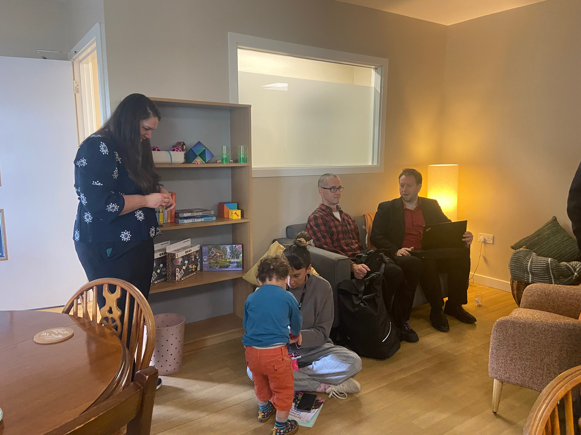




Yor Community
Wellbeing Hubs
Trailblazer
Savanna Thompson Community Mental Health Programme Manager

Slide 12
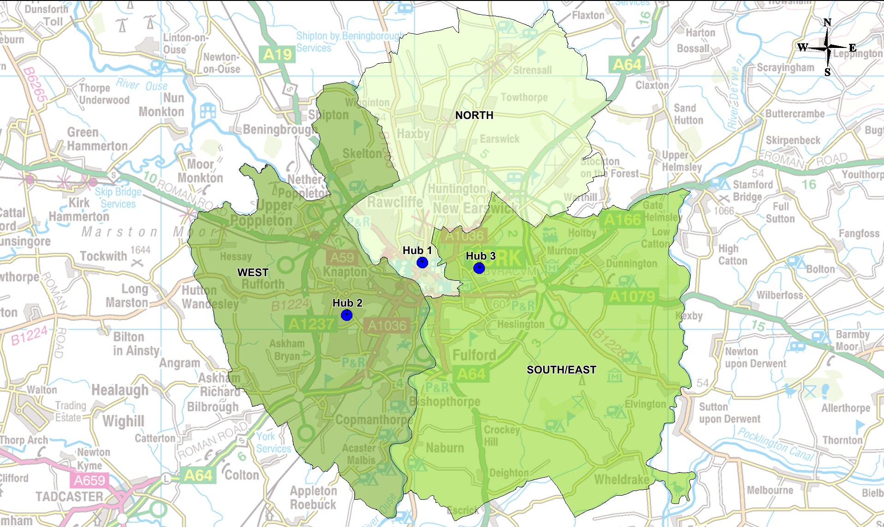
York's 3 Hubs:
Hub 1 – 30 Clarence Street The first Hub is established at 30 Clarence Street, covering the North of the City. This is a daytime offer only. A codesign process was undertaken to develop the core principles, values and practice which underpin 30 Clarence St.
Hub 2 – 24/7 Centre The second Hub is located in Acomb Garth and has been open for 7 weeks. This Hub supports the West of the City and will be 24/7 as additional funding has been secured as part of the national pilot.
Hub 3 – Future Hub The third hub will be in the South/East of the City and will be a daytime offer only. Development of this Hub is in early stages.

Slide 13







Mission & Vision
Why:
No one should face mental health challenges alone. Everyone deserves support that is personal, flexible, and rooted in their community. By working together, we can build the foundations for good mental health and wellbeing for all.
How:
Our work is led by experts by experience and communities, in equal partnership with the voluntary sector and health and social care. Together, we design support that is personal, connected, and inclusive, creating a flexible wellbeing network through local hubs.
What:
Community Wellbeing Hubs are welcoming spaces that offer practical help, emotional support, and opportunities to connect. Through local hubs you can access a range of support, in a way that works best for you.

Slide 14



Codesigned Principles
Trust – Building confidence in the support available, ensuring people feel secure and respected.
Warmth – Creating a welcoming and approachable brand that reduces stigma and fear.
Community – Rooted in local neighbourhoods, designed to bring people together.
Choice – Empowering people to access support in ways that work best for them.
Inclusivity – Ensuring the brand reflects and celebrates diversity, so everyone feels represented.
Co-production – Shaped by lived experience, with communities as equal partners in design.
Compassion – Putting care, empathy and humanity at the centre of every interaction.
Accessibility – Meeting digital and physical accessibility standards so no one is excluded.

Slide 15

Community Growth Through Trailblazer Funding
Supporting Next Steps
Strengthening Community Connections
Building Confidence & Independence
Those supported by the hubs expressed a strong desire to contribute positively to their community, turning support into active participation
By supporting people to form relationships beyond the hub, we help them feel more embedded within the wider community, reducing isolation and fostering belonging
This approach supports individuals to take the next step in their journey—developing skills, resilience, and self-assurance to thrive in everyday life

Slide 16







Yor Community Wellbeing Hubs Trailblazer -
A Partnership Approach
Practical & Emotional Support
Neurodiversity Support Programme
Supported Volunteering
Financial Capability Coaching
Employability Training

Slide 17
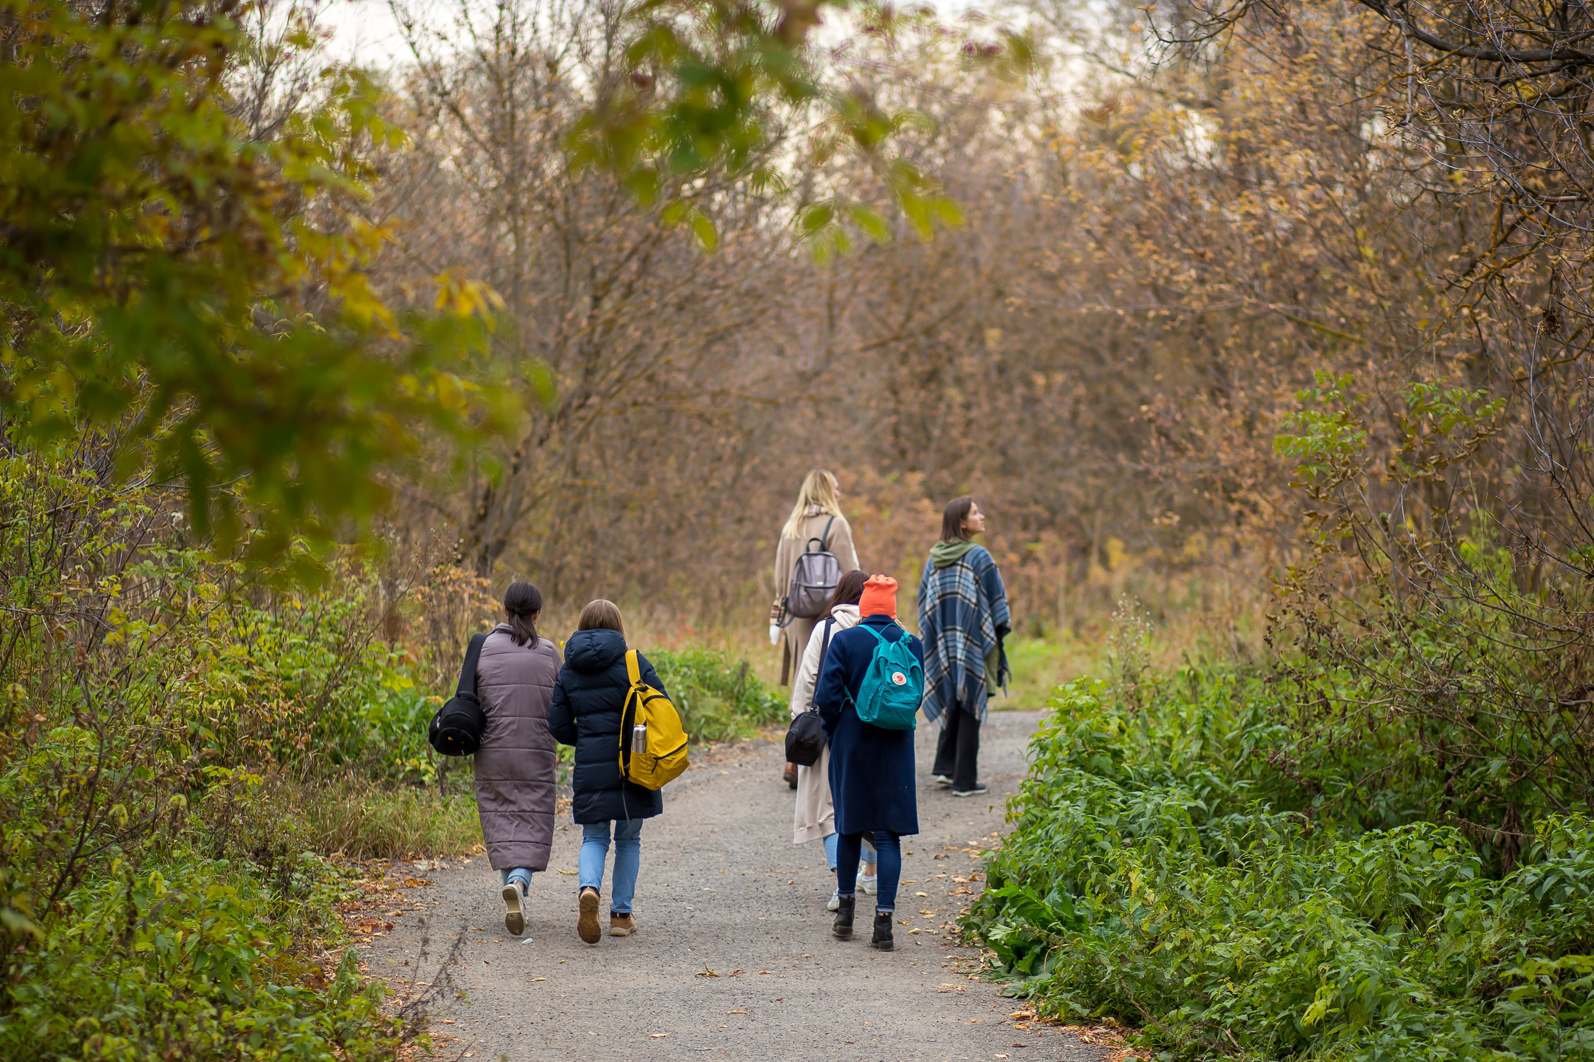
Our Next Steps
Expand Reach - Aim to support up to 100+ individuals by March 2026 and to keep building on this further
Diversify Partnerships – Open up further opportunity for individuals to expand their networks, engage in their communities and to develop wide ranging skills
Deepen Impact - Sustain support so those we're working with are empowered to go from strength to strength, to realise their potential and to thrive

Slide 18
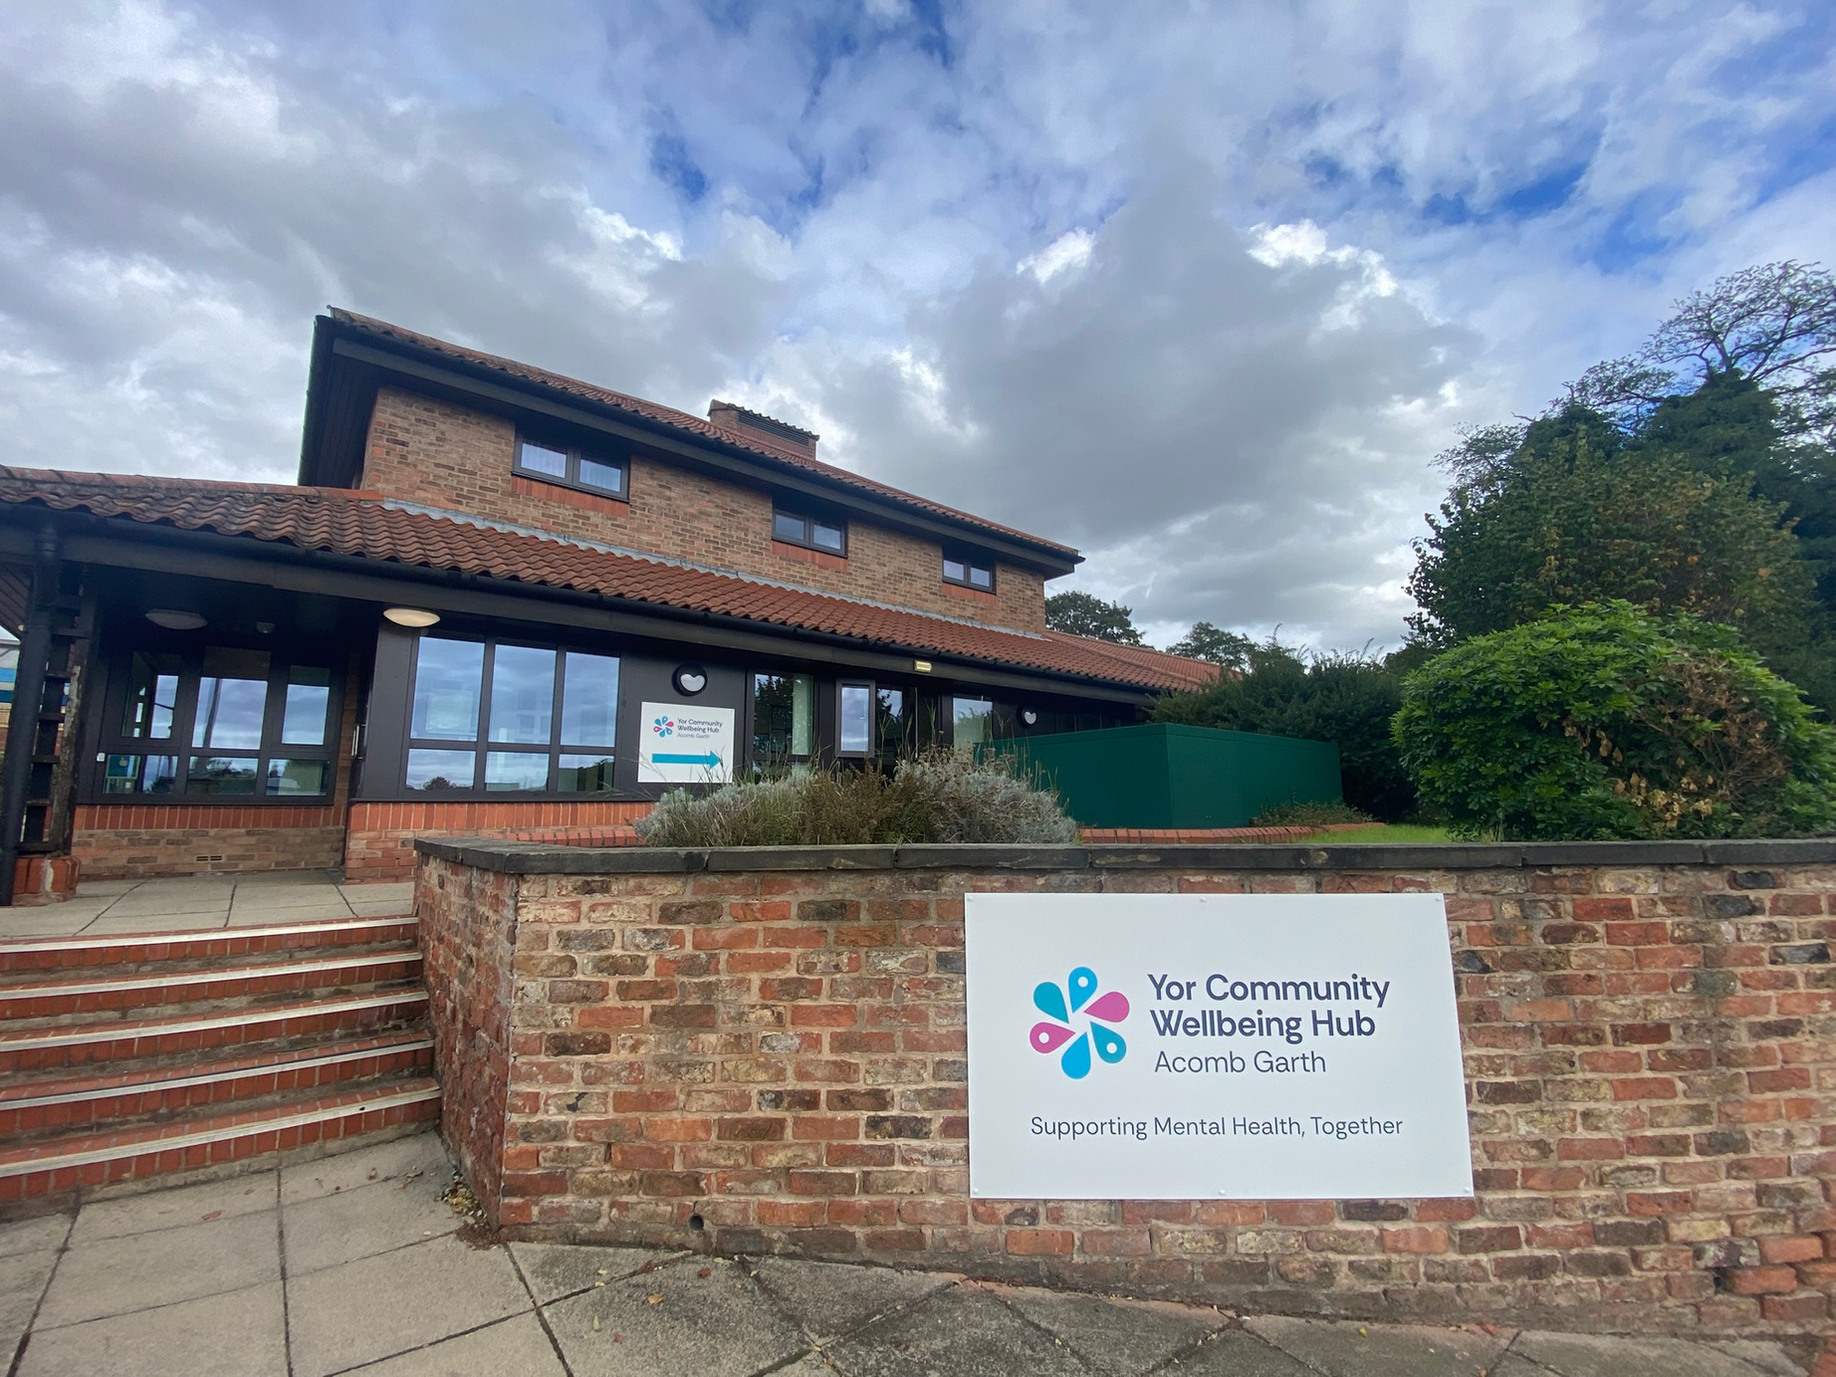
Thank you!
Email: savanna.thompson@york.gov.uk

Slide 19


Panel Discussion
Collaboration & Joining Up

Slide 20
Lunch
13:00- 13:30pm

Slide 21
Connect to Work Programme
for York and North Yorkshire

Slide 22
Overview of the Connect to Work Programme
Connect to Work is a supported employment programme designed to help individuals who face barriers to employment including disabilities, long term health conditions and other complex barriers.
It is a voluntary programme, providing tailored, one-to one support for individuals
The programme works in partnership with employers, training providers, health services and support services to create pathways into sustainable work.

Slide 23
Eligibility and Suitability
Eligible participants must have a disability or a long-term health condition or belong to one of the specified disadvantaged groups, be economically inactive, unemployed or in employed but at risk of leaving. Participants must be suitable for the programme, would benefit from the programme and are motivated to work.
• An offender (someone who is serving a community sentence) or ex-offender (someone who has completed a custodial or community sentence).
• A carer.
• An ex-carer.
• A homeless person.
• A former member of His Majesty’s (HM) Armed Forces (AF), a member of HM AF reserves, or a partner of current or former Armed Forces personnel.
•A person for whom a drug or alcohol dependency, including a history of dependency, presents a significant barrier to employment.
• Care experienced young person or a care leaver
• A refugee, a resettled Afghan.
• A person on the Ukrainian scheme.
• A victim/survivor of domestic abuse.
• Young people identified as being involved or at risk of being involved in serious violence.
• A victim of modern slavery

Slide 24
Supported Employment Models
Individual Placement Support
IPS integrates employment support into primary and secondary health services, and other support services and aims to embed work as a health outcome within the health system. This integration ideally occurs at a physical level. Caseloads 25 people
Supported Employment Quality Framework
SEQF offers a deeper level of support to both the participant and employer due to the more complex needs of the participant group. In delivery terms, this may mean that a participant will receive more contact and support from their Employment Specialist; particularly in work support for both employer and employee. Caseloads 20 people.

Slide 25
What does the programme involve?
Referral & Registration
Participants are referred by partners or self-register.
Initial assessment to understand needs and goals.
Personalised Action Plan
Co-designed with a dedicated advisor.
Focuses on skills, confidence, and job readiness.
Support & Development
Access to training, workshops, and wellbeing support.
Help with CVs, interviews, and job applications.
Employer Engagement
Opportunities to meet employers and explore vacancies.
Work trials and direct employment.
Ongoing Support
Continued guidance after starting work.
Help to sustain employment and progress.
Length of time on the programme
Those who are out of work can stay on the programme for up to 12 months
Those who are in work but at risk of leaving can stay on the programme for 4 months

Slide 26



Our Delivery Partnership
North Yorkshire
SEQF
North Yorkshire Council
IPS
Commissioned Delivery Partner
York
SEQF
North Yorkshire Council
IPS
Commissioned Delivery Partner
City Of York Council

Slide 27
Supporting Organisations
Delivery Partners
Domestic abuse refuges
Local Groups
Charities
JCP
Primary care
Probation Service
Community care
Prison work coaches
Employers
Trailblazer delivery organisations

Slide 28
Connect to Work Specifics for YNY
Support for 2530 participants over 5 years of delivery
High level timeline
January 2026
All delivery partners in place
Mid January 2026
Delivery partners start to receive people on programme
April onwards
Programme builds and able to receive increased numbers of referrals and people on programme

Slide 29
Our Partners
IPS York
Colette Gray and Tristan Fayers, York Learning, City of York Council
SEQF York and North Yorkshire
Charlotte Rudd, North Yorkshire Council

Slide 30


Supported Employment Team

Slide 31
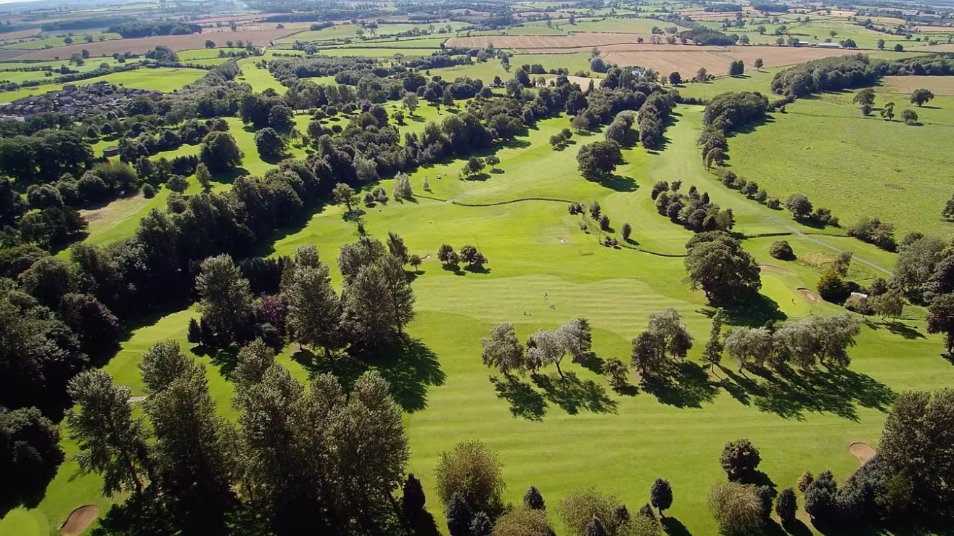
BEDALE GOLF CLUB – A GREENKEEPER ROLE FOR JOSH

Slide 32

Josh’s Story
Josh expressed a passion to work outdoors and already had some qualifications linked to this. Josh has ADHD and epilepsy, which have been a barrier to him finding and retaining paid employment in the past.
We created a CV together and a covering letter, gathered reference details and began to explore options. Identified roles and sectors that were a good job match for Josh’s skills and interests
Explored and approached some employment options including an apprenticeship which were initially unsuccessful. Feedback from these experiences led to Josh taking and passing his driving test with support and encouragement
Support provided with interview skills and practice. Josh was successful in gaining a role with Bedale Golf Club
Supported Josh and his Manager to negotiate a phased start to work, allowing Josh to build physical strength and stamina in order to be able to fulfil his role.
Supported Josh and his family around nutrition and ensuring he was consuming enough calories
Support with Josh and his employer to help him learn and remember new tasks
Regular weekly check-ins then turned to monthly check-ins.
Josh is still employed a year later

Slide 33
Employer Experience of Supported Employment:
I took on Josh Burton as a new Greenkeeper. Josh has had guidance and support from Louise prior to joining us and she has continued that support through Josh’s employment with us.
Louise has been fantastic working with me to aid Josh in all areas of taking on employment after many difficult times for himself prior. She provides a weekly call so we can update each over on his ongoing successes and has also been instrumental in assuring his family feel involved and comfortable in letting Josh flourish in a working environment.
She continues to provide guidance and ideas to keep Josh engaged and comfortable and has been instrumental personally for me in giving me the confidence to work with Josh to provide the best working environment and culture we possibly can. – Ashley Littlefair

Slide 34
Quotes from Josh, his Mum and his Manager:
Josh’s Mum (April 2025) – “It's kind of like everything has just aligned at the right time, people wise and him being ready. Ash seems to be just the right person to manage Josh. Even on occasion making sure he's eaten before driving home. Just so grateful for all the help Josh has had to be successful”.
Josh’s Mum (May 2025)– “It will be strange not having your input anymore, but that is a measure of what a fantastic job you have done supporting Josh and us as a family.”
Josh’s employer (April 2025) – “Josh’s ADHD is like a 'super power', making him very thorough with tasks”.
Josh’s employer (May 2025) – “My reward is to have 'a dedicated, hardworking, staff member like Josh….. your support has been invaluable”.
Josh (May 2025) – “Getting this job has been life changing for me” “It was really hard at first but I am loving it now”.

Slide 35
Workshops
2 Questions:
General feedback on the Plan - are there any challenges or opportunities
missing? (10mins)
2. Consideration of the priority actions (25mins)
What other actions are needed to achieve these ambitions?
How do we ensure the priority actions can be realised?
3. Each table to feedback with 1 priority from each question (10mins)

Slide 37
The next 3 year plan is being prepared
Have your say:
Employers:
https://chamber-survey.co.uk/wny/skills/
Stakeholders:
https://chamber-survey.co.uk/wny/skills-stakeholders/
If you would like to input further contact: skills@wnychamber.co.uk

Slide 38



